Slide 1
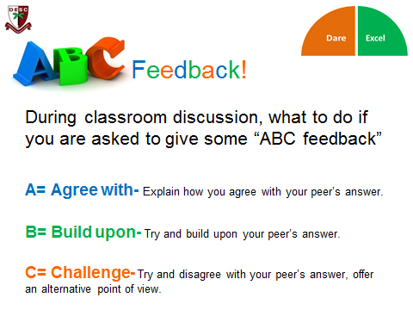
ABC feedback
The teacher asks students a question and then targets someone to answer. The student then target one of their peers to Agree with; Build upon; or Challenge their answer and the question then gets bounced around the room by the students.

