Slide 1

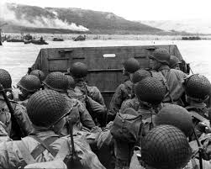
What evidence supports this?
Explain using evidence how it suggests D-Day was significant
Which sources meet these criteria?
Which of the G.R.E.A.T
criteria?
Ground-
breaking
Terrifying
How
significant
was D-Day?
Affected the
future
Remembered
Effects

