Slide 1




Are you a hex-pert?
Bronze Hex-pert
You can identify and explain the images on their own
Silver Hex-pert
You can make links between the images and explain them
Gold Hex-pert
You can make an overall judgement about the impact of Nazi persecution of Jews in the 1930s
SPaG Bomb
To really highlight your understanding – remember to use key historical terms
E.g. Kristallnacht!

Slide 2

Big Question
How were Jews persecuted in the 1930s?
Jude = Jew
The 1935 Nuremberg Laws meant that Jews could not vote

Slide 3

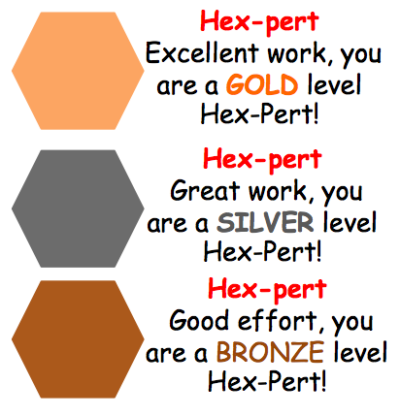
Peer Critique
Using a red pen, you are going to peer assess your visual hexagons
Remember we are trying to IMPROVE their work!
Using the stickers on your desk
Level your neighbours work
Write feedback on a post-it note:
WWW – How could they improve?
EBI- How could they improve?
Think, what is their next step to level up?

