Slide 1
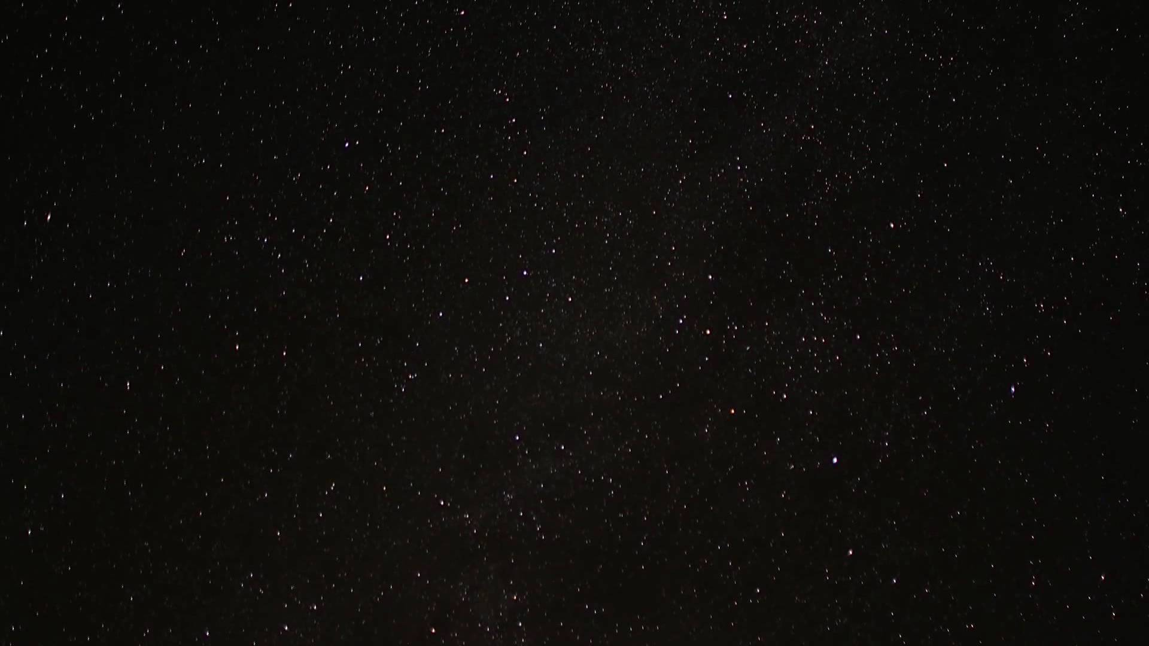

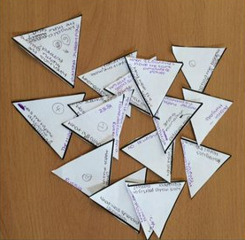
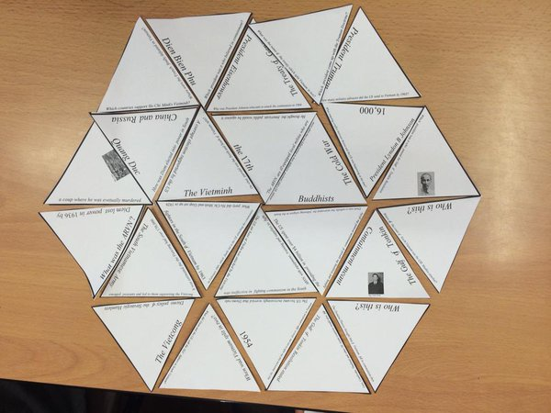

Your Task
Spread out the cards on your desk
You need to arrange triangles into a hexagon
The first group to complete wins!
Help
Align the sides of each triangle with the matching answer, quote, picture or sentence

