Slide 1

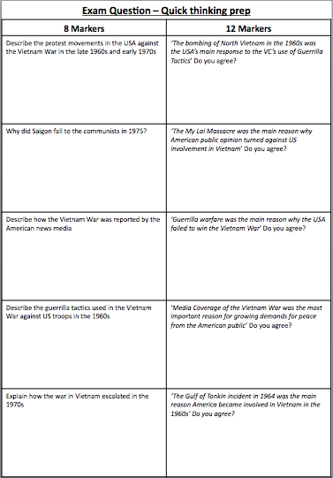
Quick Thinking
Exam Questions
A key exam skill is planning your answer within the first minute reading the question.
This can involve simply writing the 2/3/4 paragraphs you will write.
You have 30 seconds on each question to micro-plan for each of these past paper questions

