Slide 1
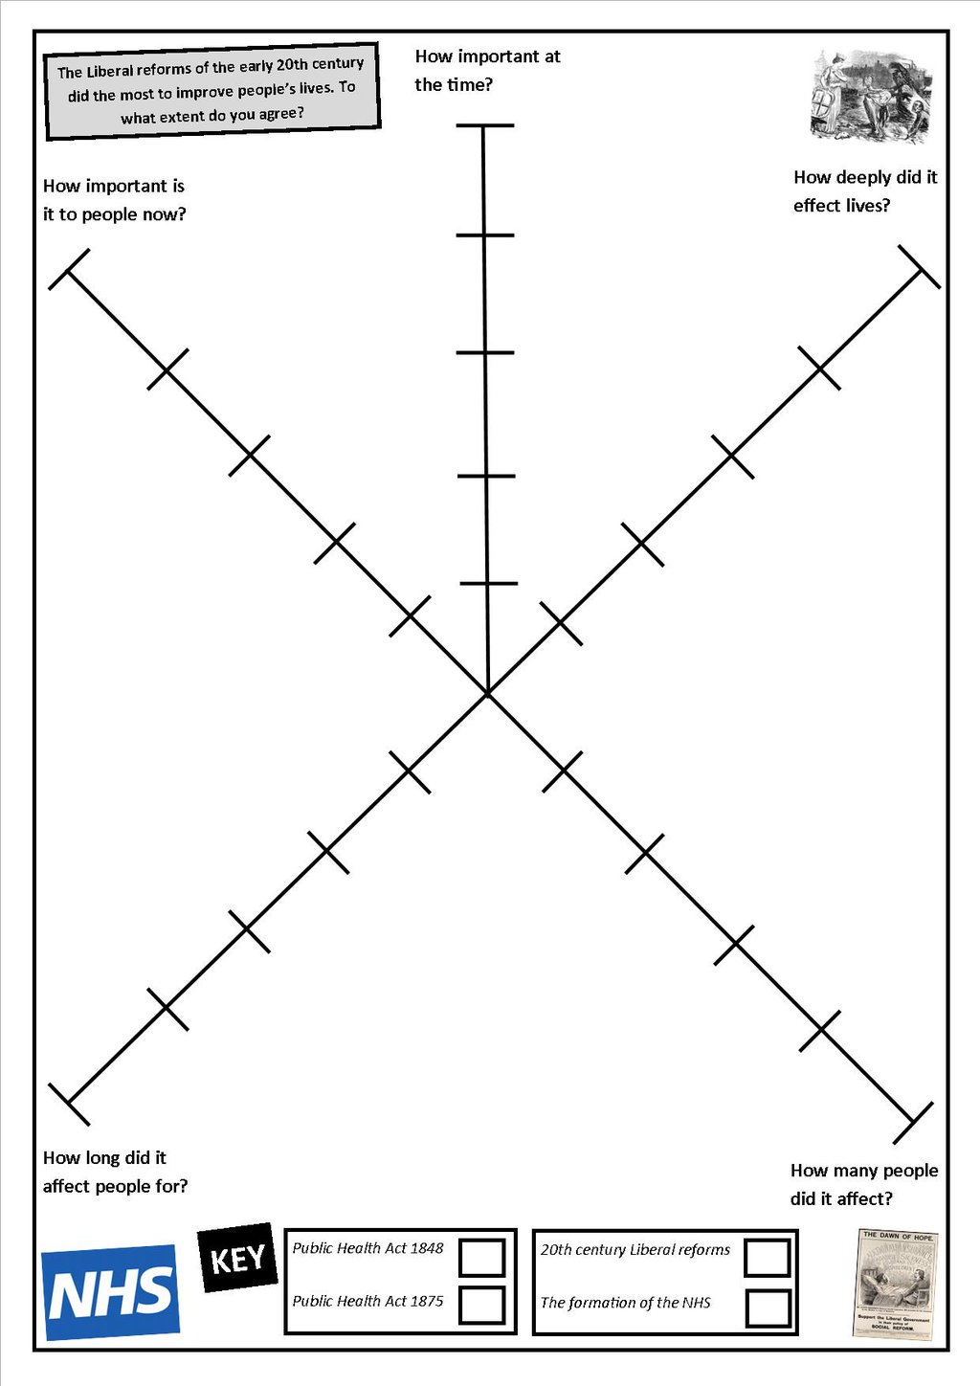

Significance Star
1. On your star, put a cross to on the line to represent the reasons importance.
2. The closer to the reason the more important.
3. Join up the crosses when complete!
How to:
2
1
3
5
4
Overall Judgement
Imagine this is your conclusion, balance it!

