Slide 1
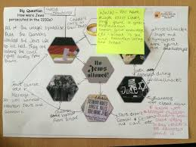

Why did the population grow between 1750-1900?
Create your own Visual Hexagon
You are familiar with this activity but today you will take it one step further by designing your own hexagons AND explaining them.
Task
Read the information sheet
Identify 6 reasons the population grew that you can draw
Once drawn, annotate to explain

Slide 2
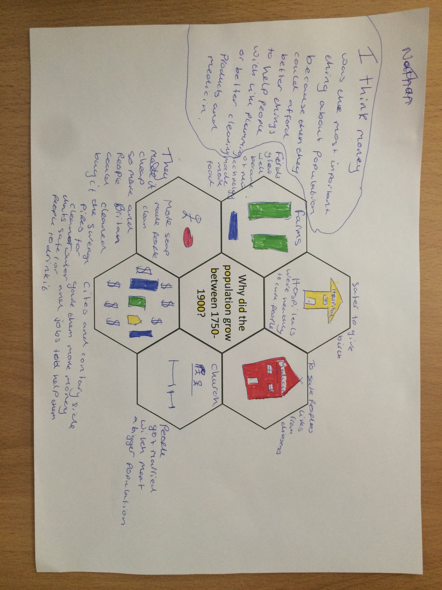
Example

Slide 3

Why did the population growth between 1750-1900?

