Slide 1


Visualisers within the classroom
Meols Cop High School
www.meolscophighschool.co.uk
Use for modelling, assessment & feedback
Greg Thornton
History Subject Leader

Slide 2

Meols Cop High School
www.meolscophighschool.co.uk
Rationale
How can I better help students understand the thought process in extended answers?
How can I develop my use of feedback after assessments?
Blog post inspiration by:
@susanSenglish and Michaela school https://susansenglish.wordpress.com/2017/10/15/why-i-love-live-modelling-for-across-the-curriculum/

Slide 3
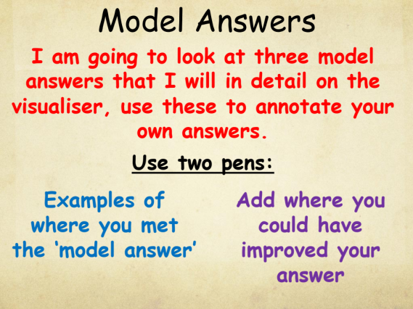
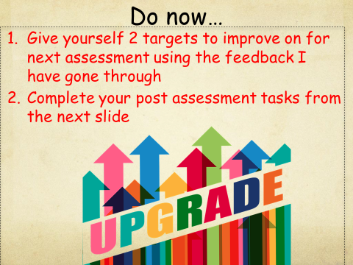
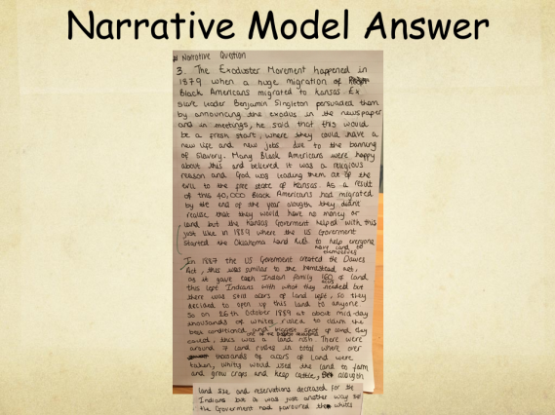
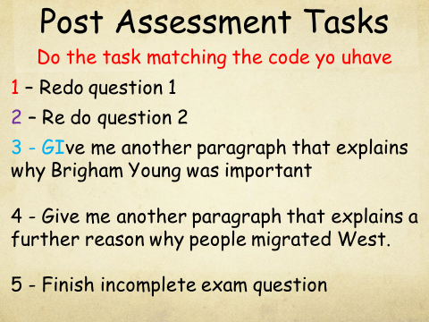
Meols Cop High School
www.meolscophighschool.co.uk
Assessment Feedback
Use in feedback sessions
  Mock remark a model answer using visualiser
  Students compare vs. their own answer
  Using 2 pens to add improvements or acknowledge meeting model.
  Set own targets based on visualizer session
  Redraft question, paragraph or new answer using model as guide

Slide 4
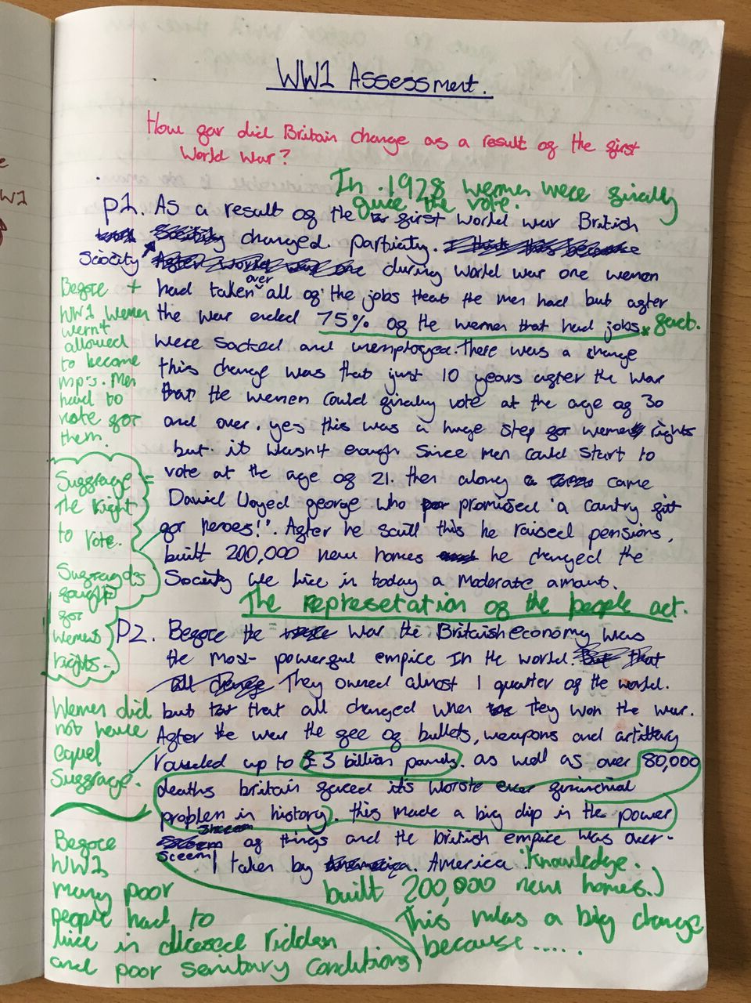
Meols Cop High School
www.meolscophighschool.co.uk
Assessment Feedback

Slide 5
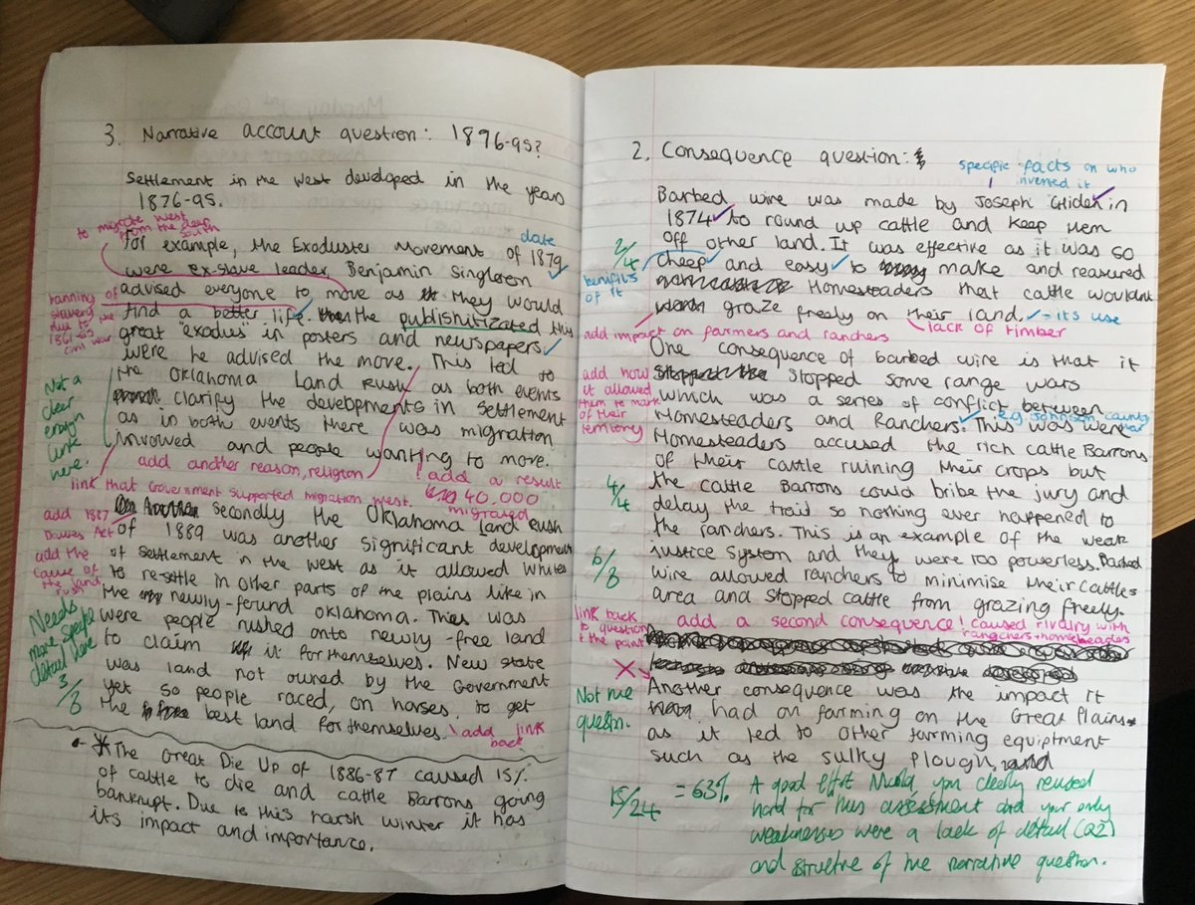
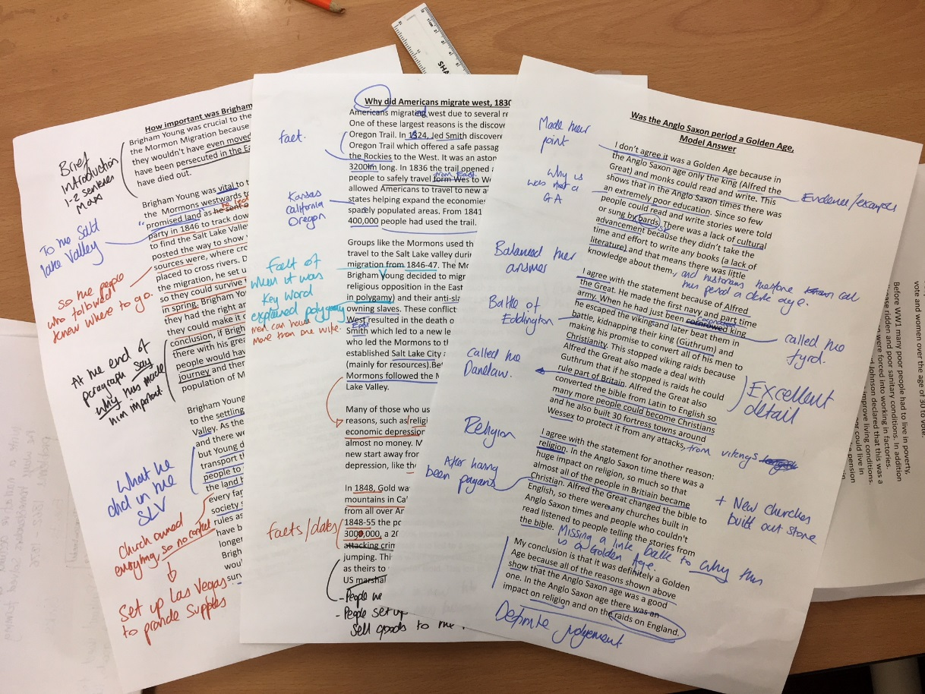
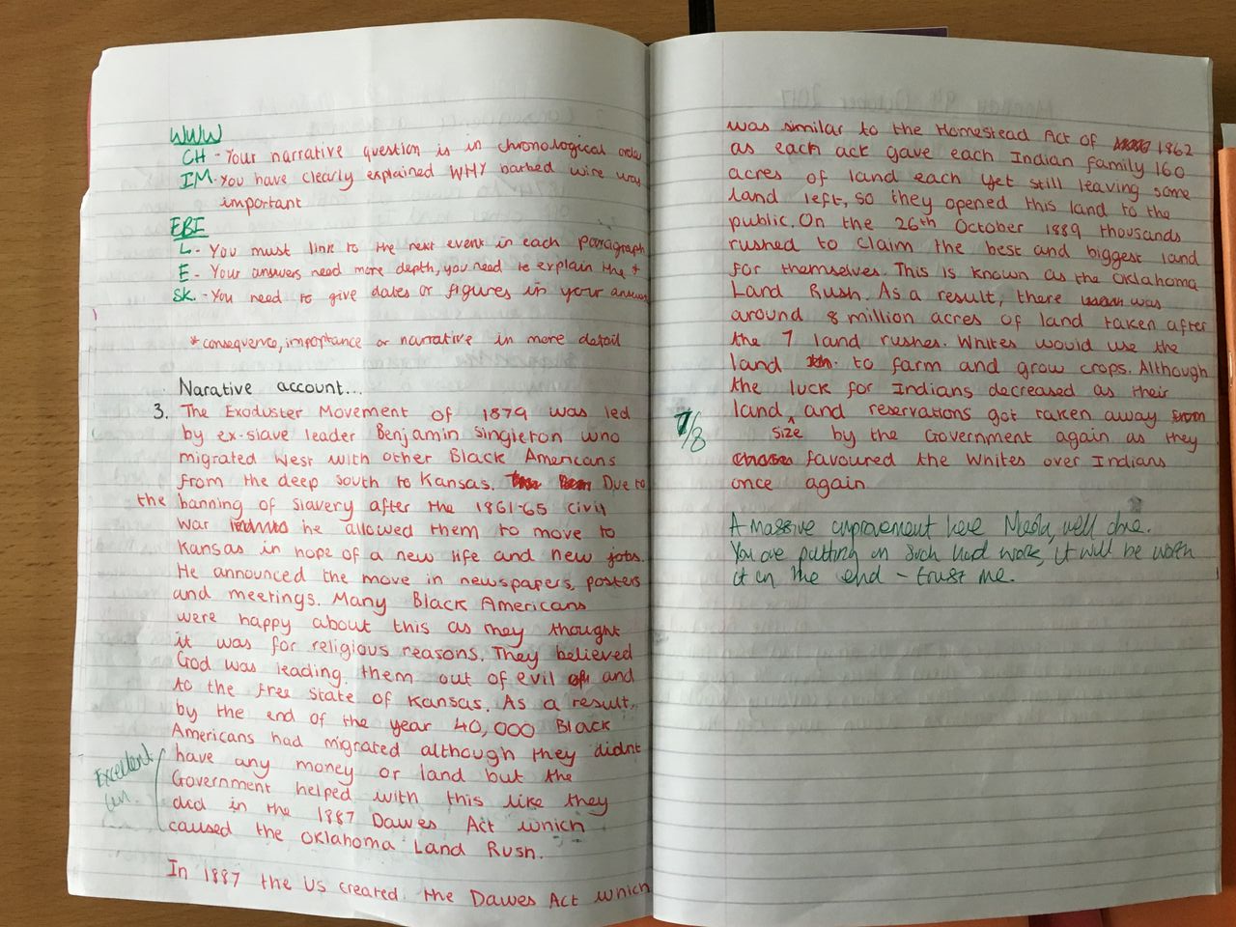
Meols Cop High School
www.meolscophighschool.co.uk
Assessment Feedback

Slide 6
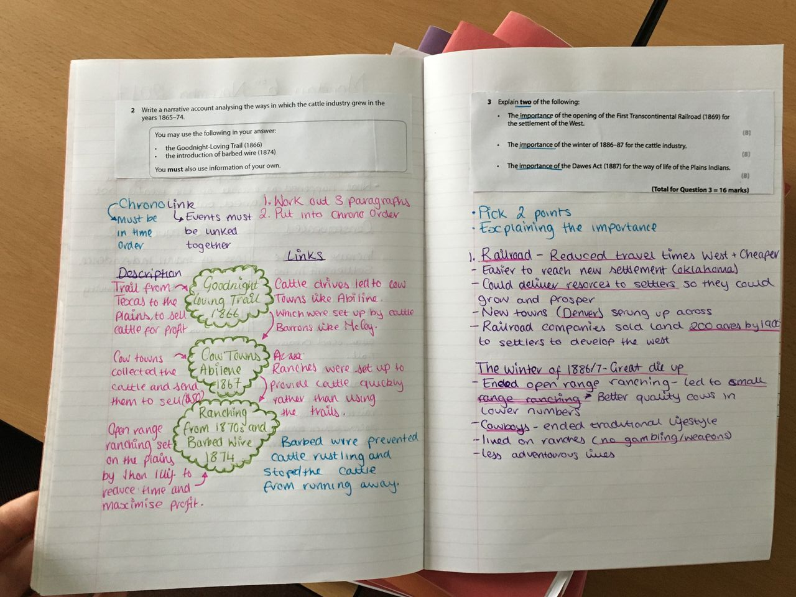
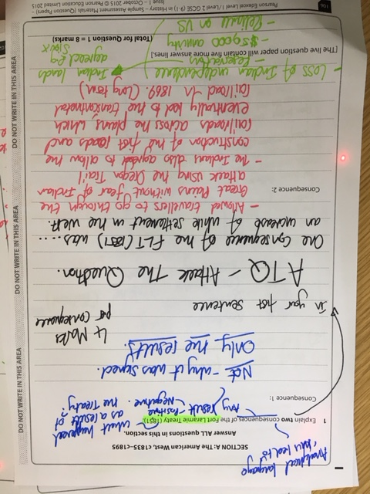
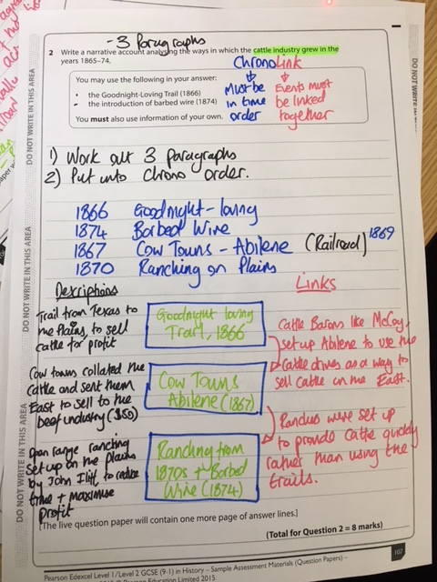
Meols Cop High School
www.meolscophighschool.co.uk
Walking Talking Mock & Microplanning
Picking apart exam papers on visualizer, Students copy what is written into books
‘How to approach’ sessions. They see approach of teacher to exam questions
Walking talking exam questions written by teacher in exam cond.

Slide 7
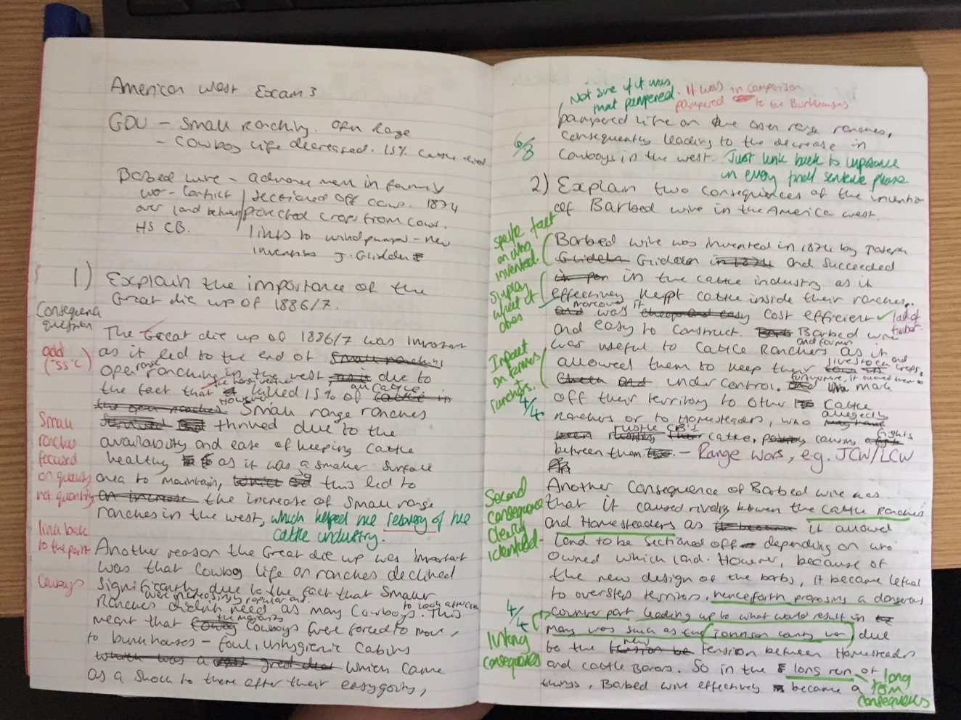
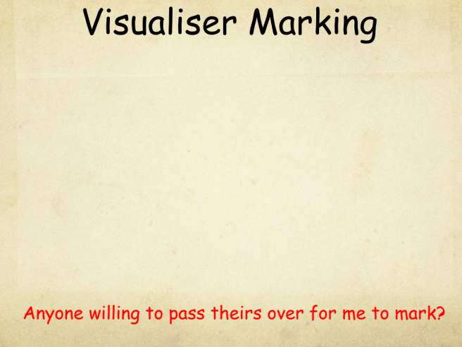
Meols Cop High School
www.meolscophighschool.co.uk
Live Marking
Simply used to live mark assessments or written answers within lesson
Can also put under visualiser, screengrab & work on IWB

Slide 8
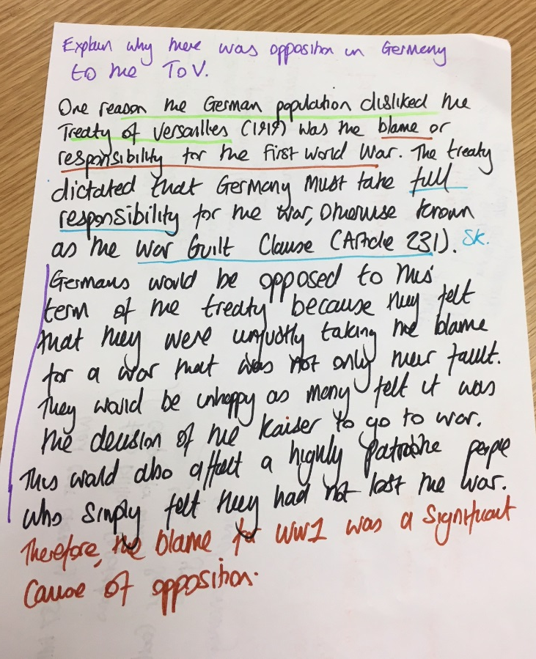
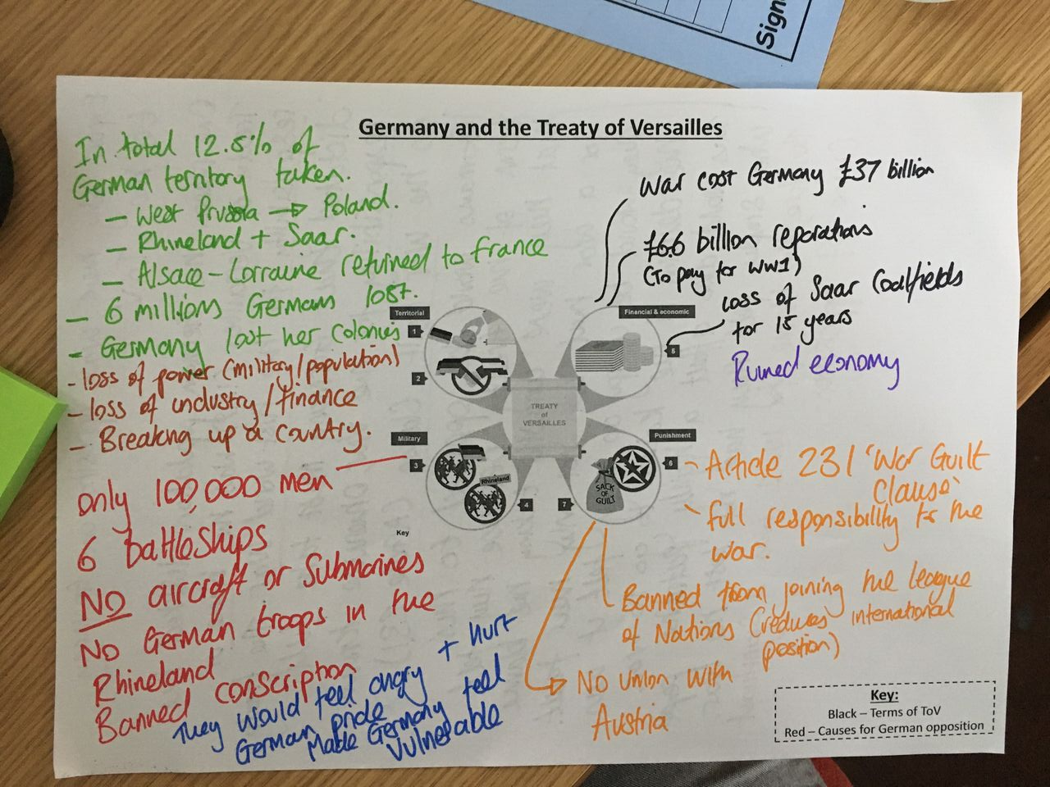
Meols Cop High School
www.meolscophighschool.co.uk
Use in revision
Using visualiser to live model a written assessment answer using student led writing.
Mind mapping with alongside students
Example from revision session

Slide 9
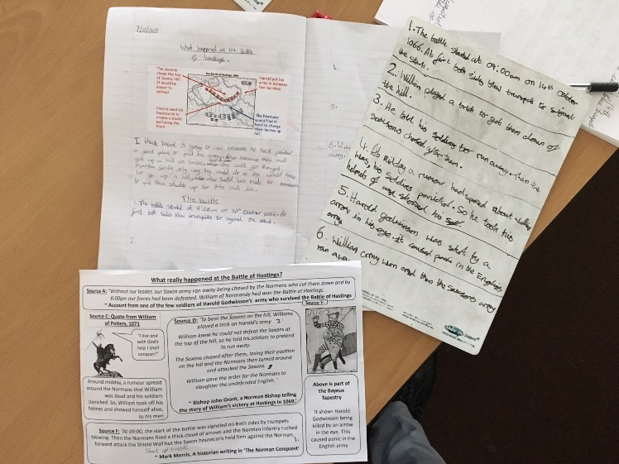
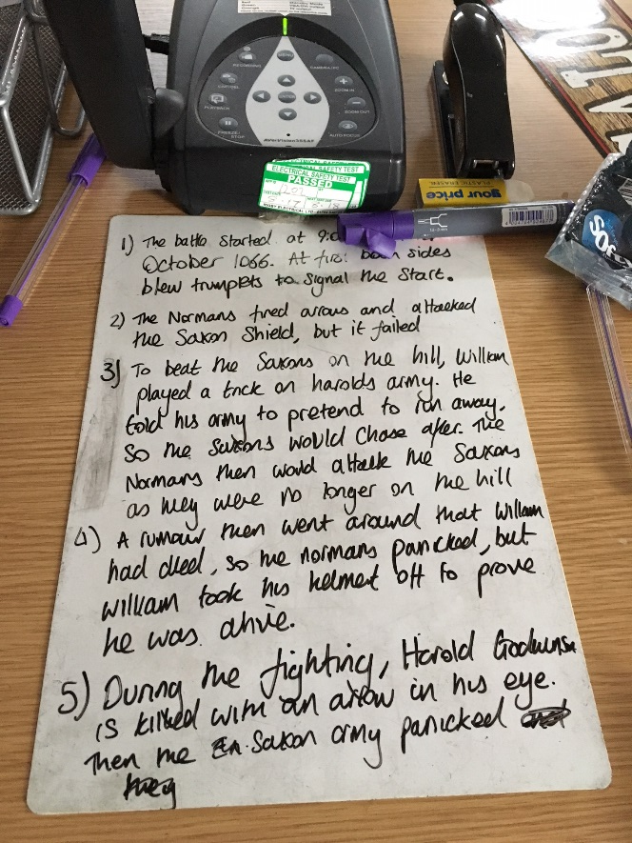
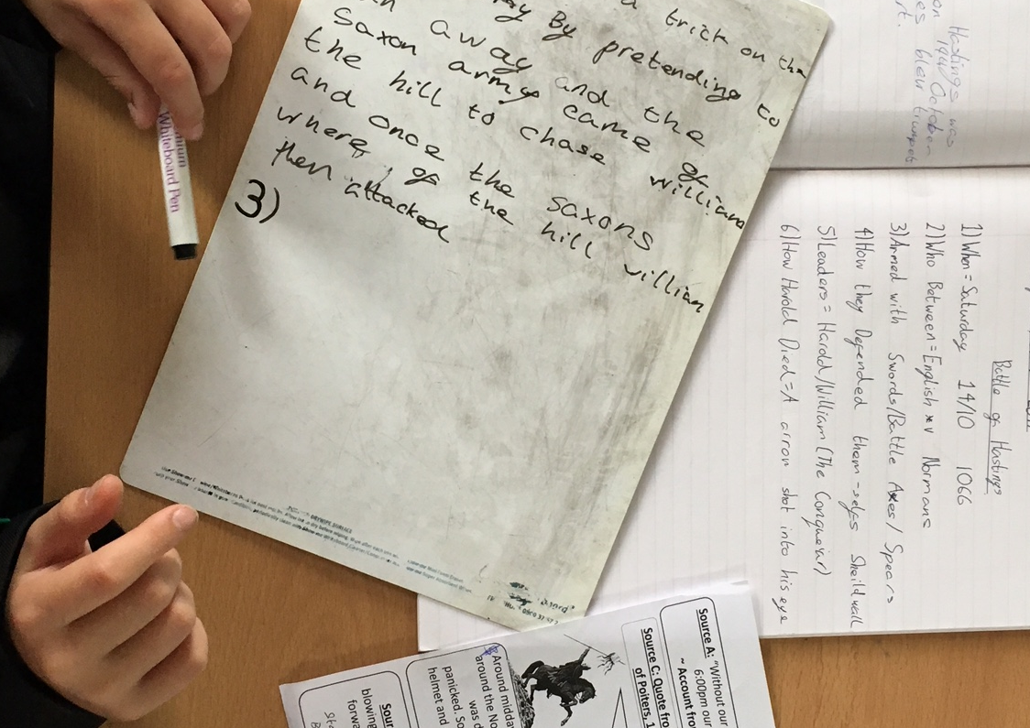
Meols Cop High School
www.meolscophighschool.co.uk
Crowd Sourcing
Using visualiser to write out answer piece whilst students plan on wipeboards then provide input, corrections and then copy into own books
Example from Y7 lesson on writing a narrative on the Battle of Hastings

Slide 10
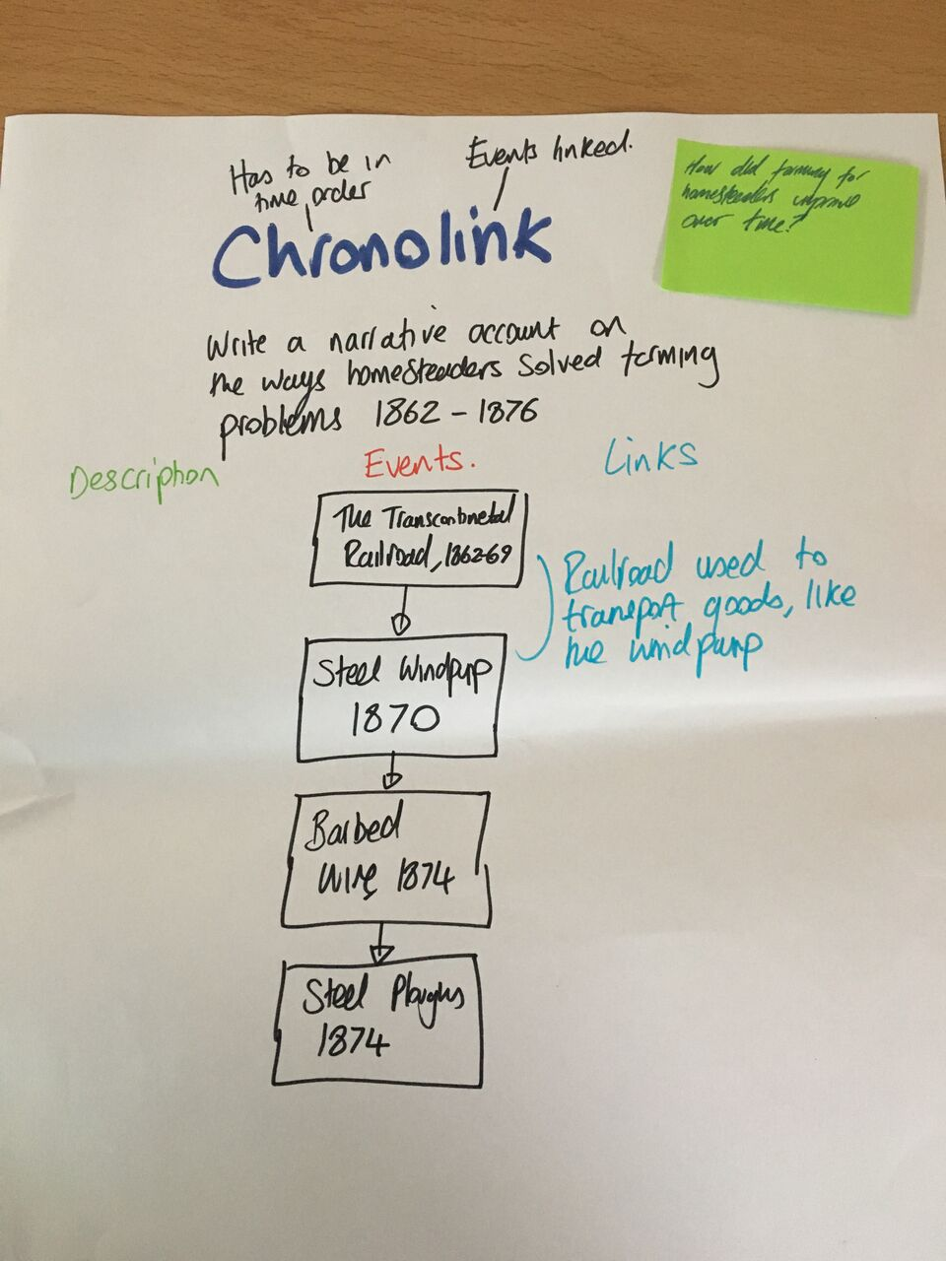
Meols Cop High School
www.meolscophighschool.co.uk
Revision
’Post it planning’
Students create an exam question and we plan out answer using visualiser around the answer.
Y9 student wrote out a question and I picked from boards to plan out using their guidance

Slide 11
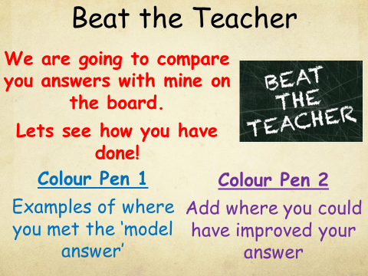
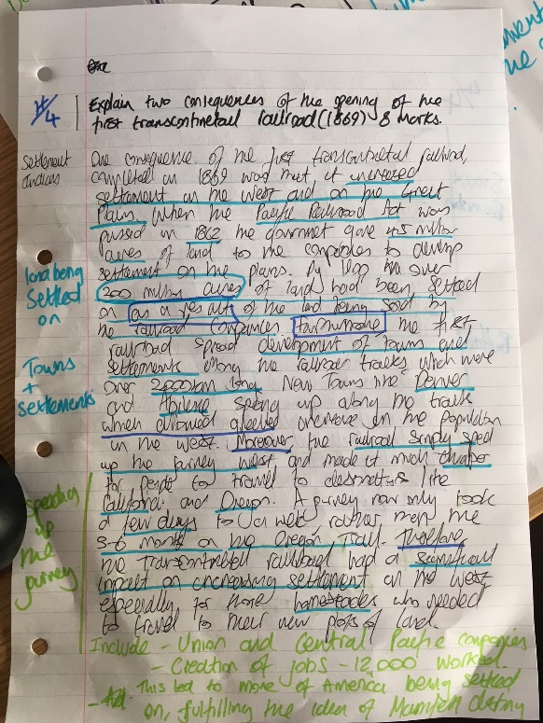
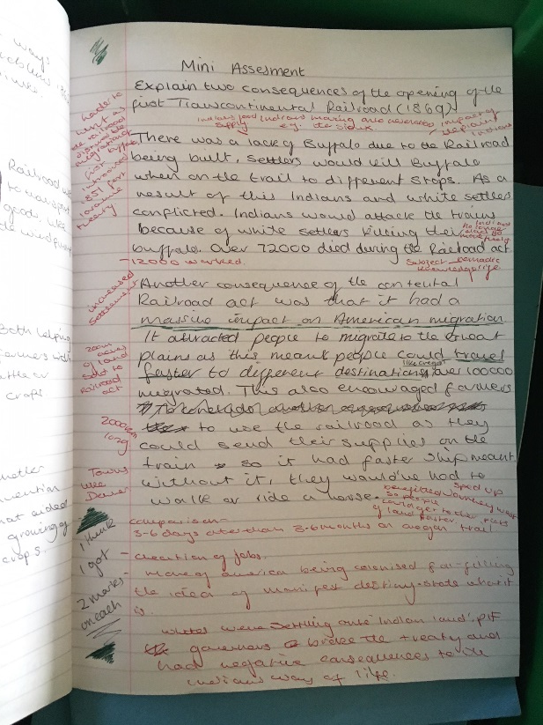
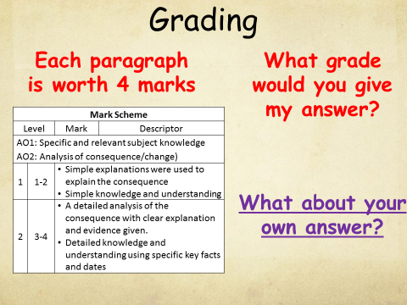
Meols Cop High School
www.meolscophighschool.co.uk
Revision
‘Beat the Teacher’
Teacher answers exam question alongside students, then students compare their example to their own & make improvements and re-write section before it is marked.

Slide 12
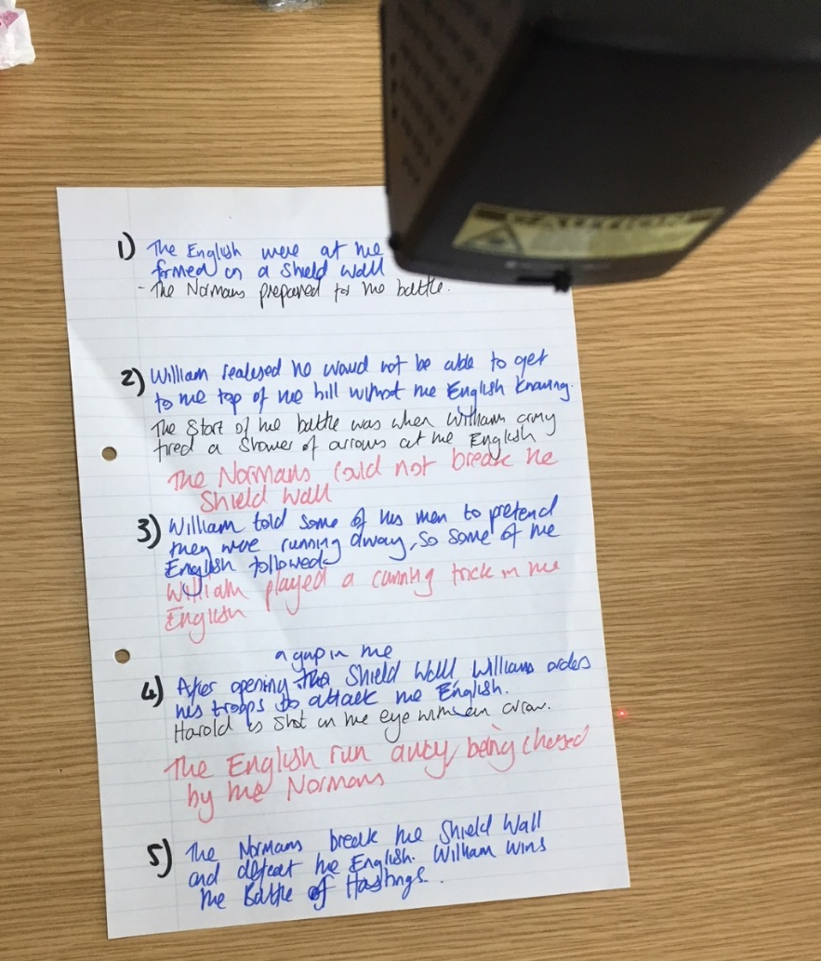
Meols Cop High School
www.meolscophighschool.co.uk
‘Demonstrating’
Use of visualiser to demonstrate application of a skill e.g source analysis, writing a conclusion, an argument paragraph
Modelling the stages of construction & explaining each stage

Slide 13
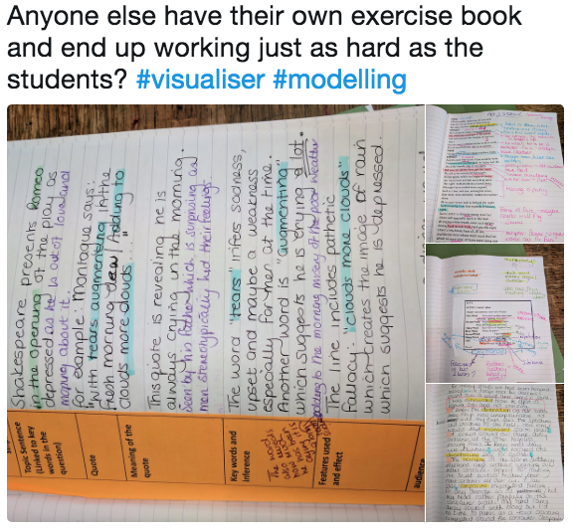
Meols Cop High School
www.meolscophighschool.co.uk
Where next?
Developing other ways to use the visualiser
  Creating a modelling exercise book? All examples in one book for re use
  Comparative judgment: students to compare two examples & discuss
  Visualiser challenge: selecting random work weekly to praise/critique
  Improving my handwriting!

