Slide 1
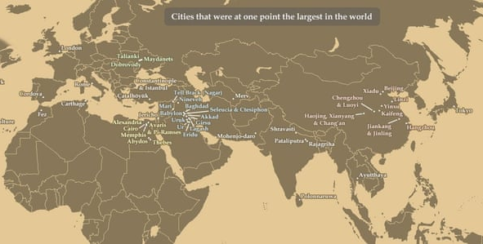
If I was to ask you where you think most of the world’s history happened, where would you suggest?
“Today, Tokyo is the most populous city in the world; through most of the 20th century it was New York. A century earlier London was the world’s population centre, and Baghdad a millennium before that.” The Guardian Newspaper

Slide 2
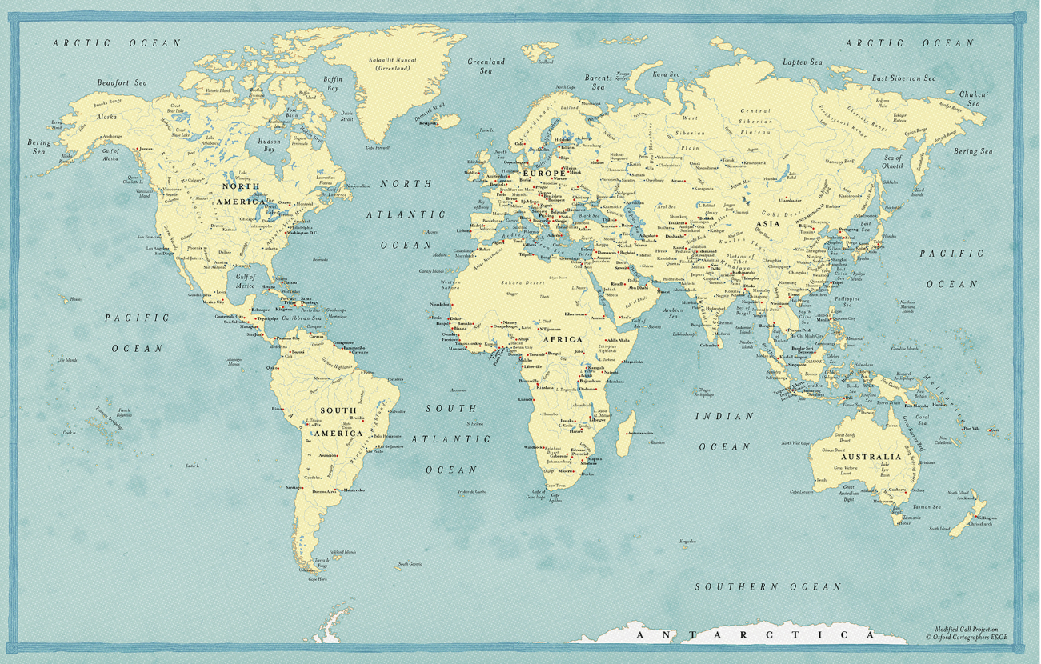
A map of the Modern World
This is the map of the Modern World
What is the difference?

Slide 3
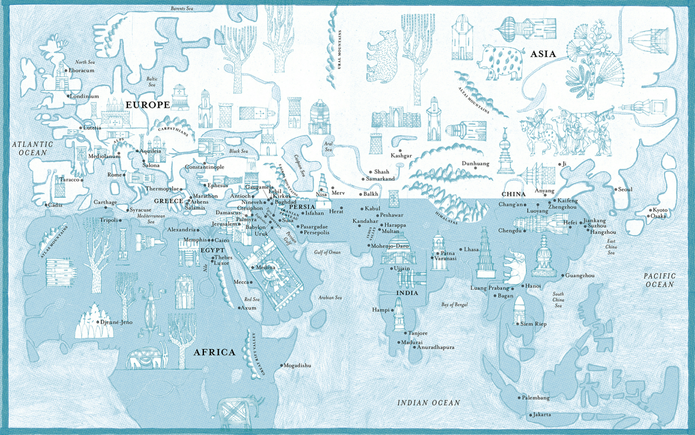
A map of the Ancient World
Where are most cities located on here?
Where is the ‘centre’ of this map?
Is there anything missing from this map?

Slide 4

Taking it further, comparing maps
Map of the Ancient World
Map of the Modern World
What is the difference between these?
Where are most cities located in this world map?
Most are located in around the Middle East and Asia
What is a central focus of these maps?
The ancient map has the Middle East at its centre, not the ‘West’
Is there anything missing from these maps?
There is no America or Australia
Answers to these questions in the chat

Slide 5
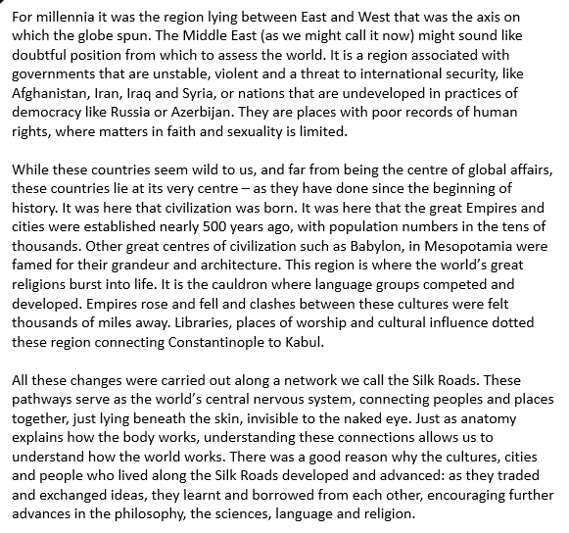
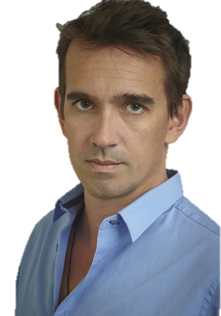
But....this doesn't’t fit our historical narrative?
In his book The Silk Roads, historian Peter Frankopan has argued that to best understand the world, we don’t look at the West (Europe) but to the the East, where nations that sat on the most important network of the ancient world, The Silk Roads.
“For millennia, it was the region lying between East and West that was the axis on which the globe spun. It was in the Middle East (as we might call it now) that civilisation was born, the great religions burst into life and where empire rose and fell and clashes of cultures were felt thousands of miles away, all connected by the Silk Roads.
Frankopans challenges the traditional view that history is white and western
Notes:
Ask for readers for the speech bubbles.

Slide 6
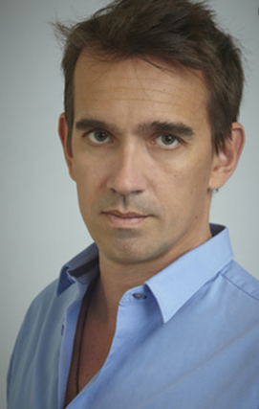

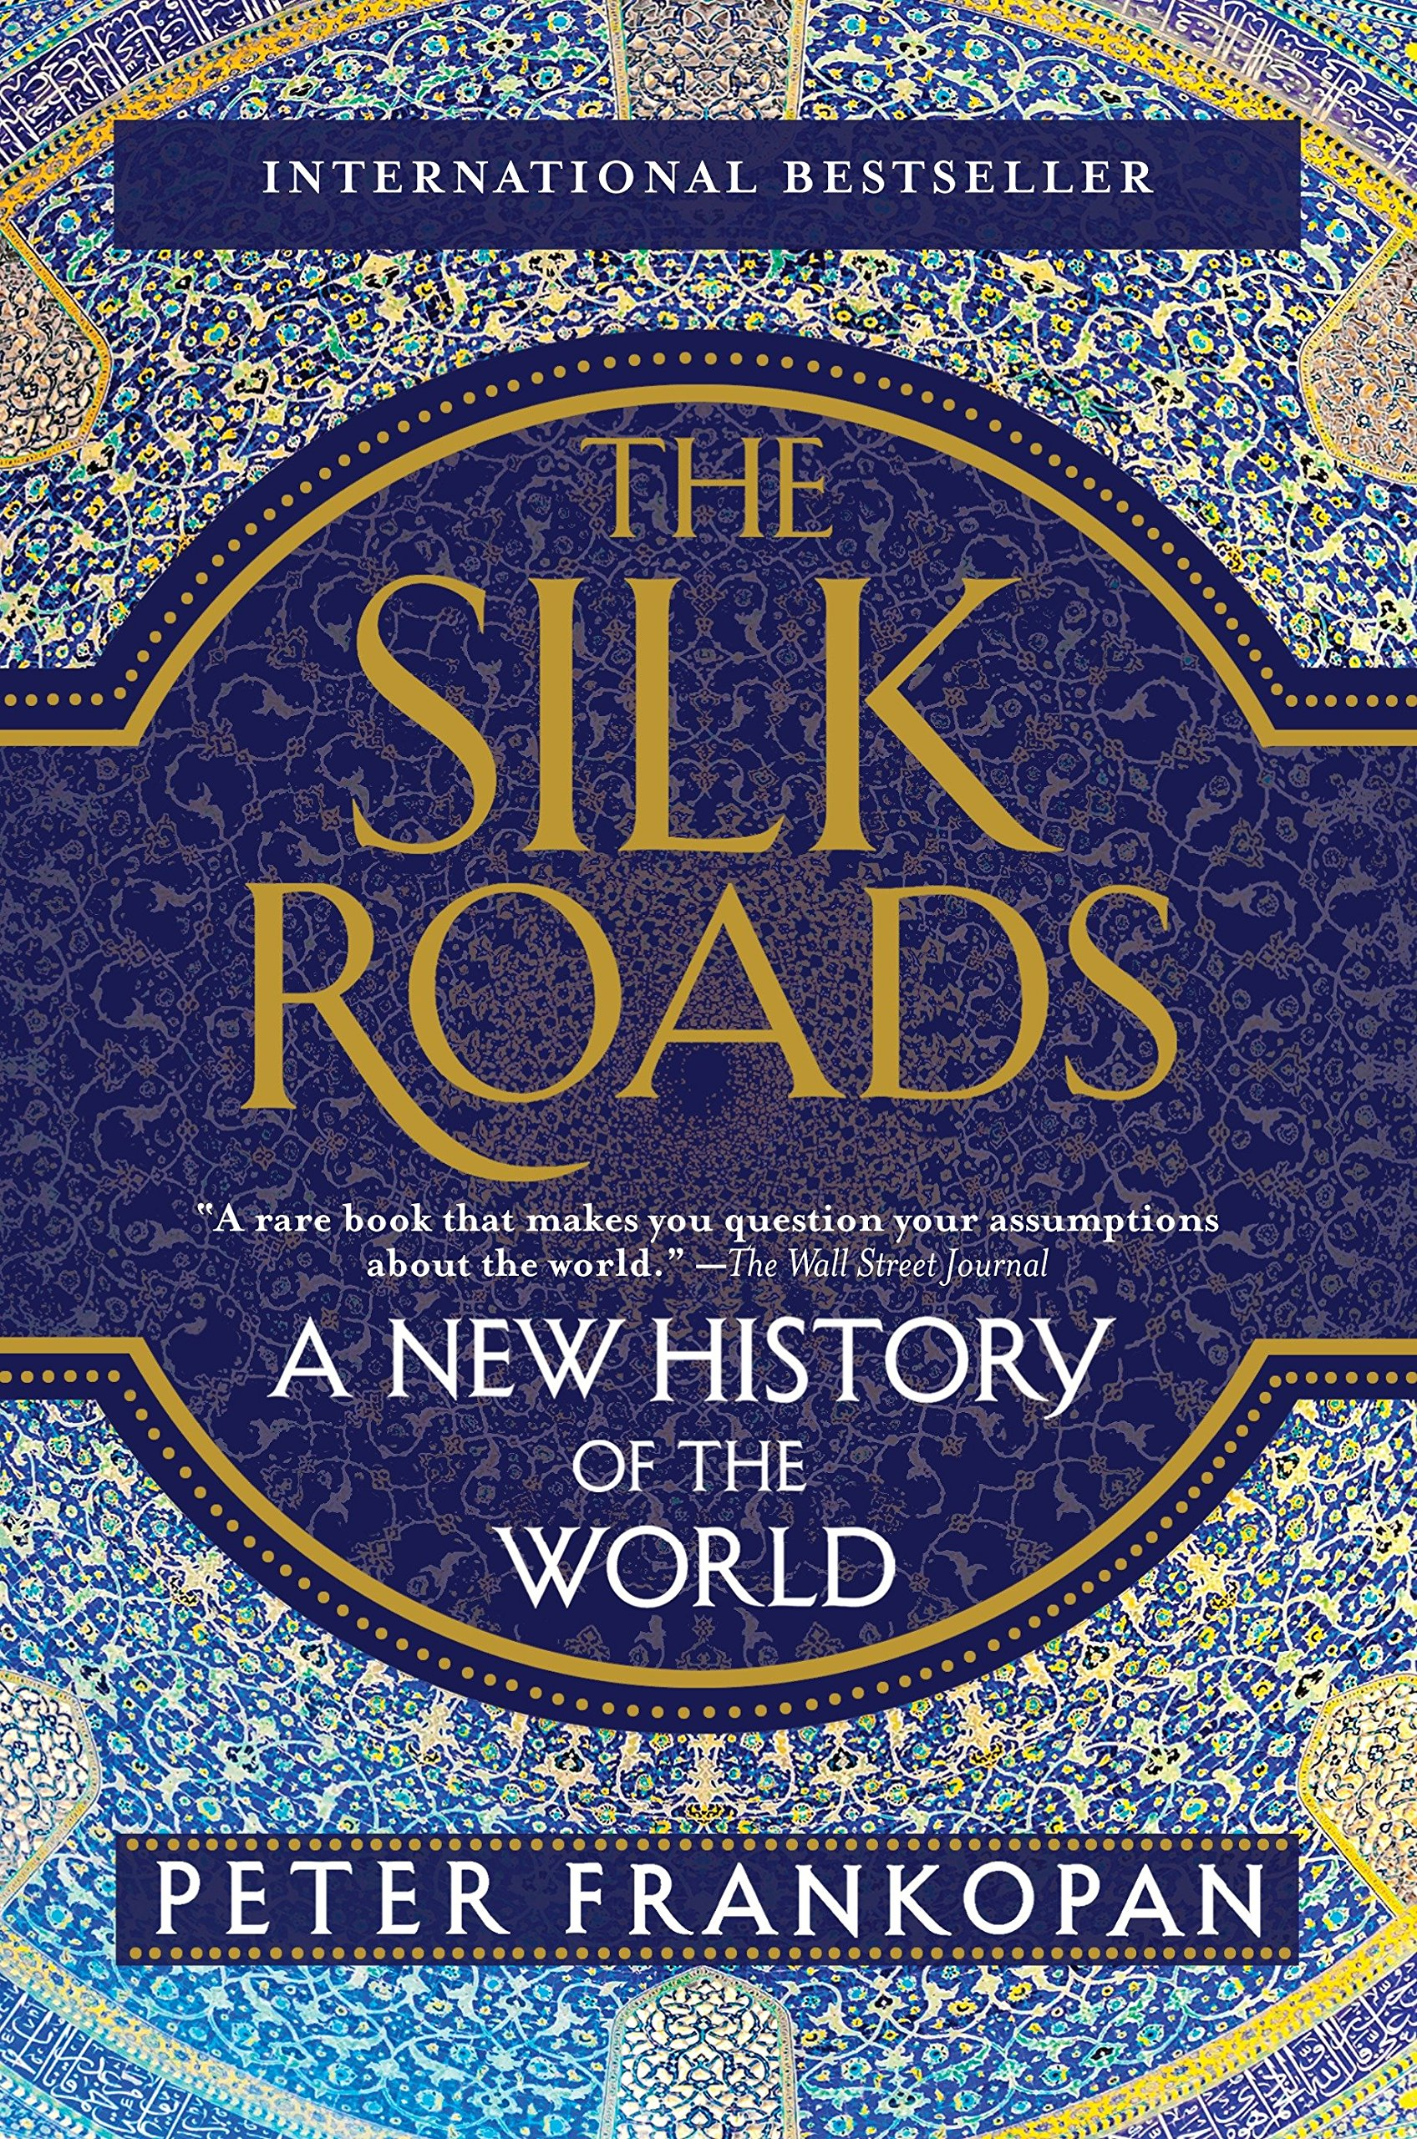
Enquiry: What travelled on the Silk Roads?
In his recent book The Silk Roads, historian Peter Frankopan has argued that in order to understand the world, the best place to look is not in the centre of the West nor in the heart of the East, but to the nations on the old Silk Road where East and West come together. To be generic, today we would call that the area of the Middle East.
For more than two millennia, news and information, goods and products, ideas and beliefs have flowed through networks linking the Pacific coast of China with the Atlantic coasts of North Africa and Europe, the Indian Ocean and the Persian Gulf with the Mediterranean and Scandinavia. Since the late 19th century, these networks have been known as the Silk Roads.
Our enquiry focuses on the ‘Silk Road’ and the goods, ideas, religious and cultures that travelled back and forth across it over millennia.
Our enquiry is based off the ground-breaking work of Peter Frankopan, who wrote The Silk Roads, who says this about it
He argues that The Silk Roads are the world’s central nervous system, connecting otherwise far-flung peoples and places. These networks are invisible to the naked eye – just as the body’s veins and arteries lie beneath the skin. Understanding the Silk Road and its connections provides an essential corrective to established narratives of the past, and more.
To understand the world of today and tomorrow, you need to understand the world of yesterday. And to do that, the best place to start is at the beginning. As luck would have it, that means starting with the Silk Roads.
But firstly, what are the Silk Roads?

Slide 7
The story continues
So far this year we’ve studied early migration and the development of England in the Middle Ages between the 11-13th Centuries.
Early Migration to England
800,000 BC – 10th Century
Norman England
The 11th Century
Medieval Kingship
12-13th Centuries
Early Britain
The Middle Ages
The Silk Roads
The 2nd Century BC to 15th Century
Now is time to take a step back and look at how the wider world developed during this period, looking at the Silk Roads
This Silk Roads existed for over a millennia (1500 years), spanning most of what we have covered so far this year, and our future topics

Slide 8
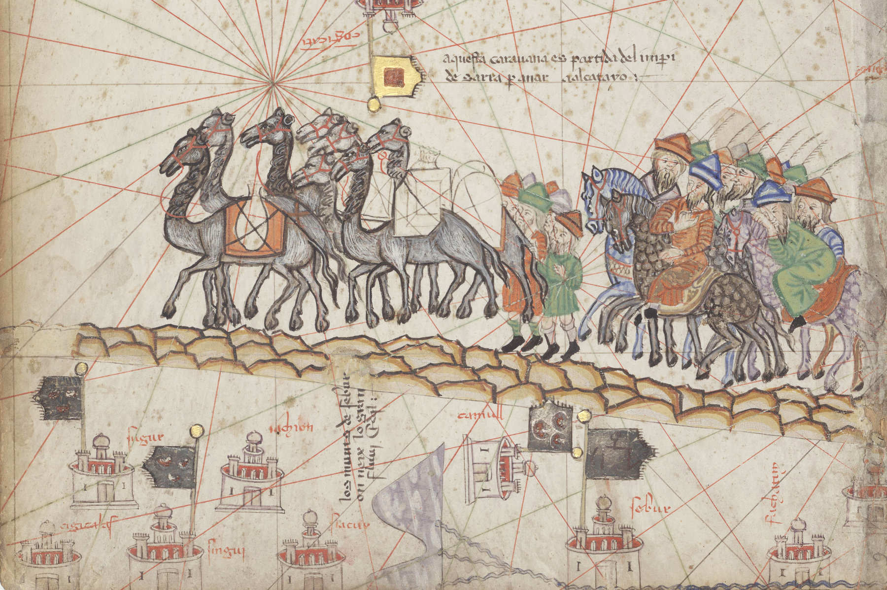
Neither Silk nor Roads;
What were the Silk Roads?
Enquiry Question: What travelled on the Silk Roads?

Slide 9
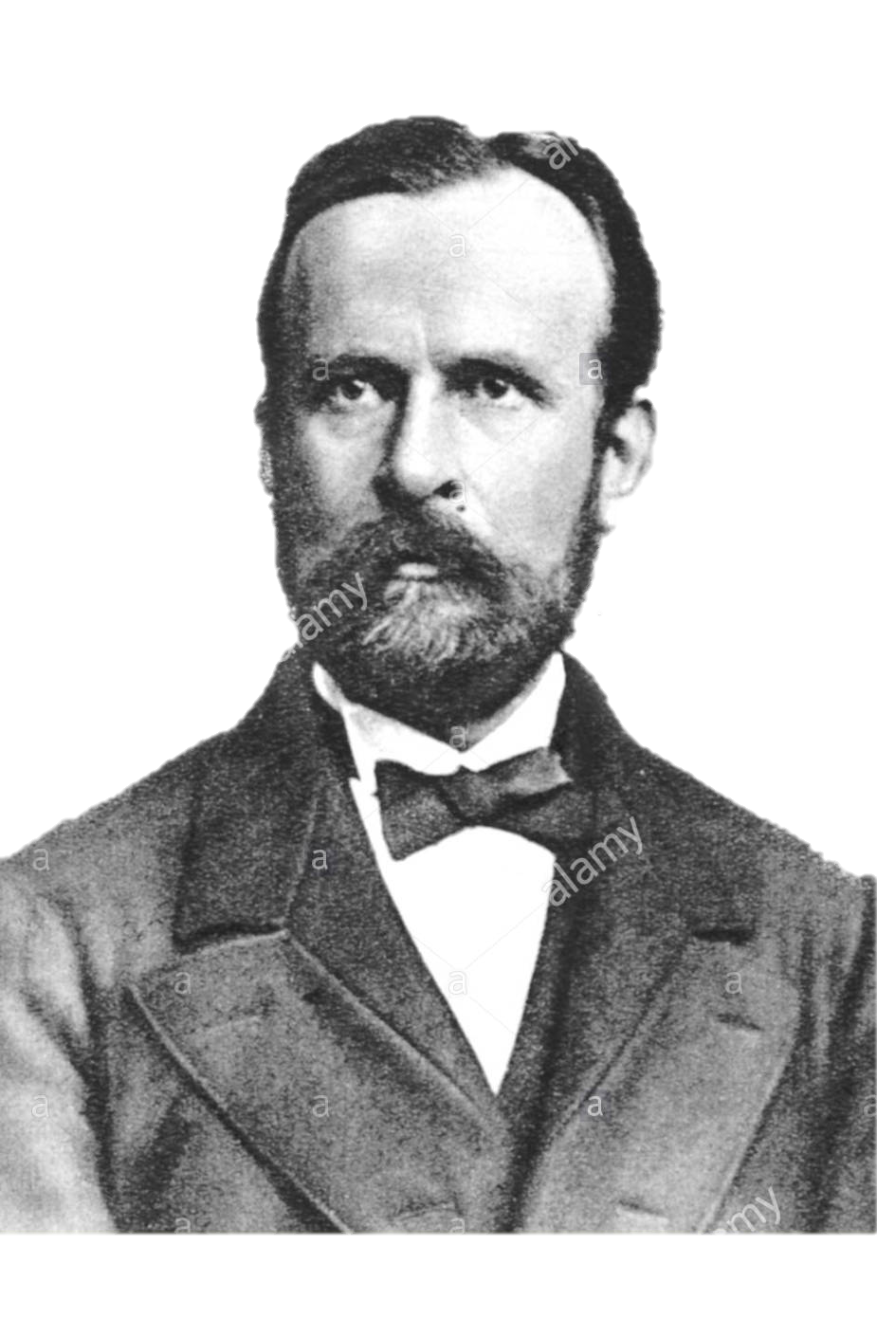
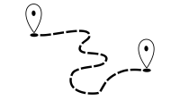
The Silk Road was a network of trade routes which connected the East and West (which allowed economic, cultural, political, and religious interactions between these regions, nations and empires.)
So, what are the Silk Roads?
So we have mentioned the Silk Road a lot, but what does this key term actually mean?
The name was made up German geographer, Ferdinand von Richthofen in the 1800s, almost 400 years after it closed
Can you think why he called them this?
Definition: The Silk Roads
The Silk Roads was network of trading routes between the Eastern and Western worlds ( mainly Asia and Europe).
Task: Copy out this definition into your books.

Slide 10

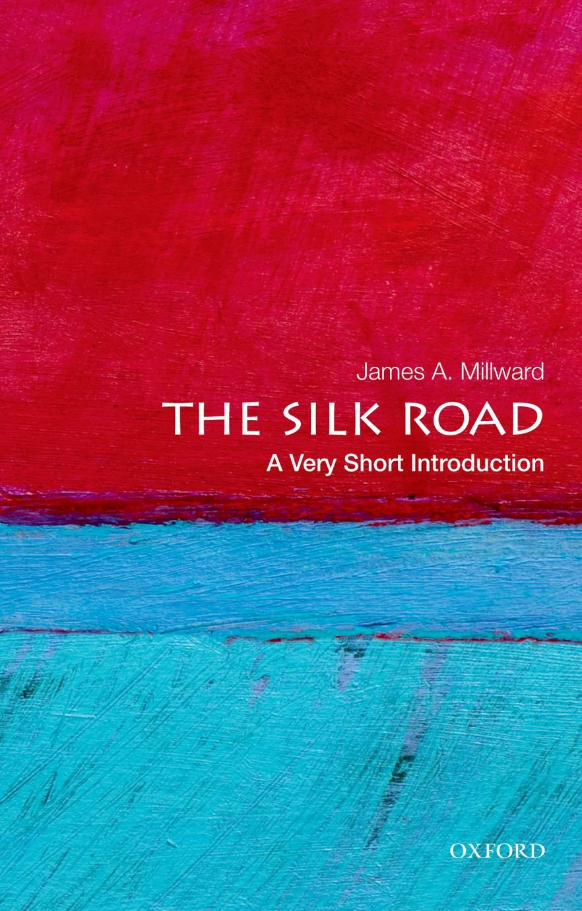
Neither Silk nor Roads
History is filled with misconceptions about the past
Definition
Characteristics
A view or opinion that is incorrect because based on faulty thinking or understanding.
Stereotypes
Based on inaccurate knowledge/myth
Something factually wrong
Misconception
Examples
Non Examples
Vikings wore helmets
People in the past are stupid
Hitler was Jewish
The Holocaust led to the death of
6 million Jews
The Vikings raided England
In ’A very short introduction to the Silk Roads’ J. Milliard identifies peoples’ misconception of the term, stating the Silk Road
was ‘neither Silk nor road’ but something much more complex
Task: Write a sentence about the Silk Roads using ‘Misconception’
Notes:
As nouns the difference between misconception and misunderstanding
is that misconception is a mistaken belief, a wrong idea while misunderstanding is a mistake as to the meaning of something; erroneous interpretation; misconception

Slide 11
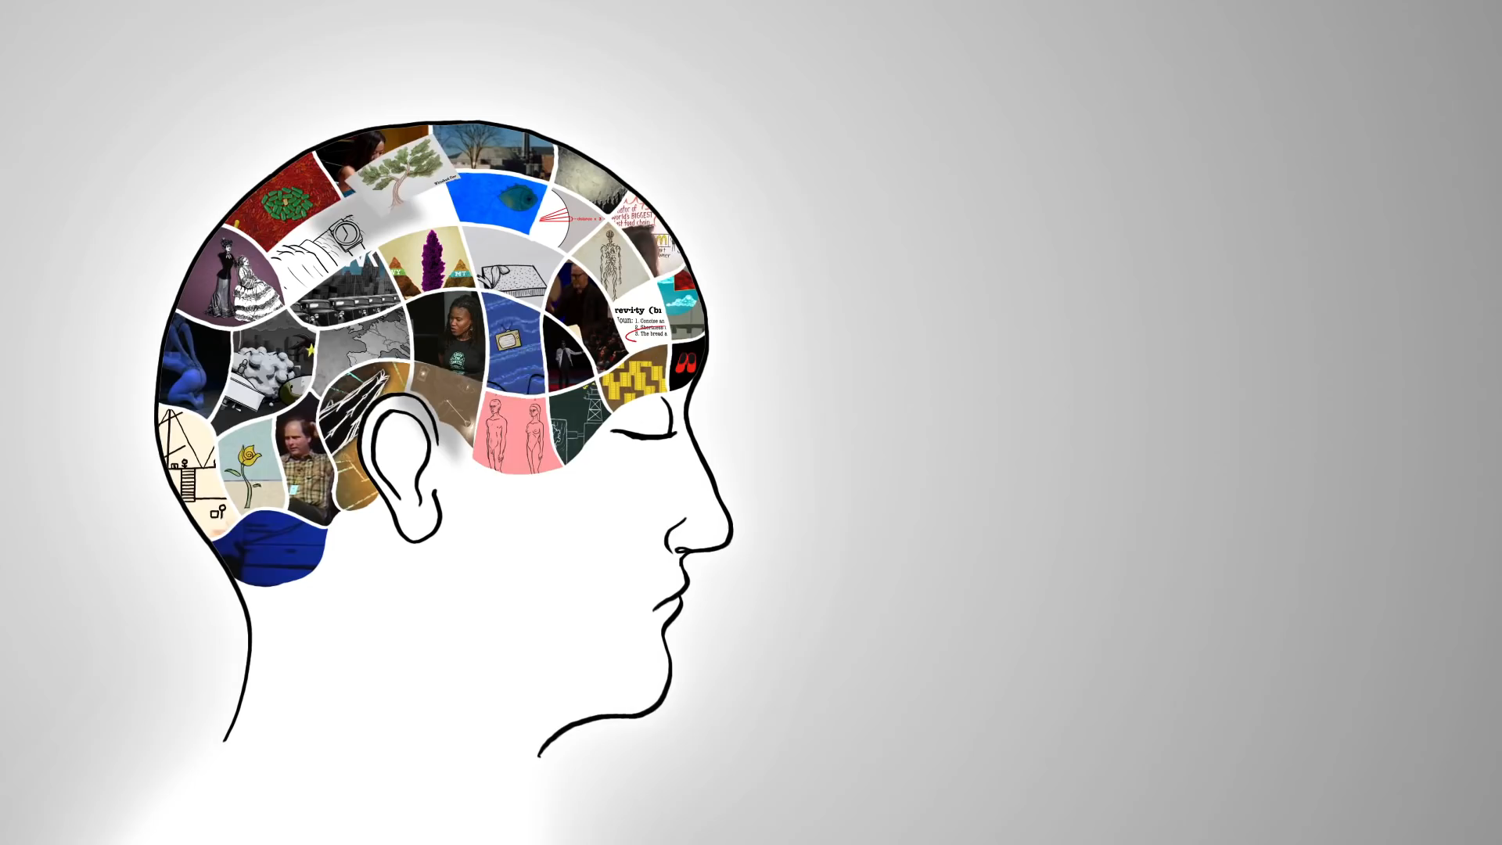
The Silks Roads: A brief introduction
Task: Complete a mindmap, titled, ‘What travelled the Silk Roads’ as we watch the video. I will pause at points!

Slide 12
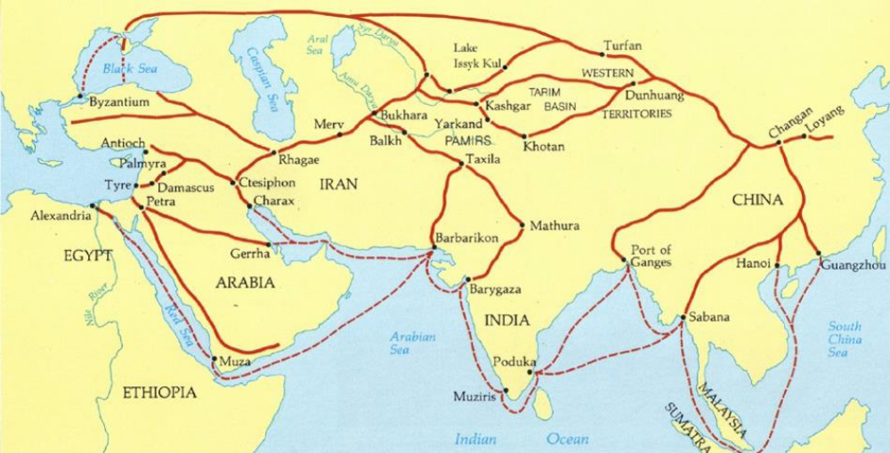
Mapping The Silks Roads
Mediterranean Sea
The Silk Road extended approximately 6,437 kilometers (4,000 miles) across some of the world’s most formidable landscapes, including the Gobi Desert, linking the Mediterranean Sea and Pacific Ocean.

Slide 13
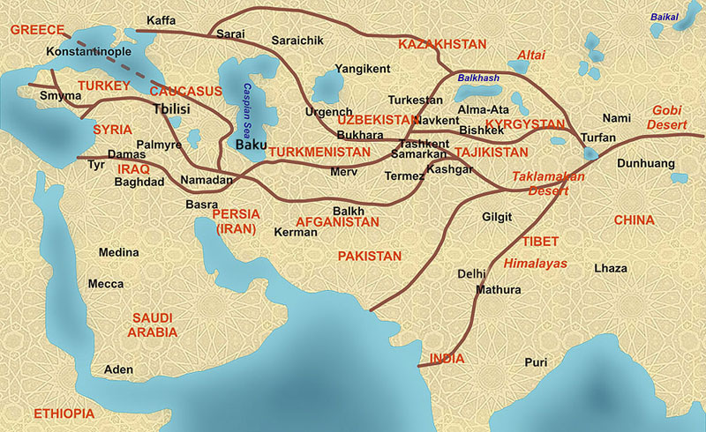
Map with modern names

Slide 14
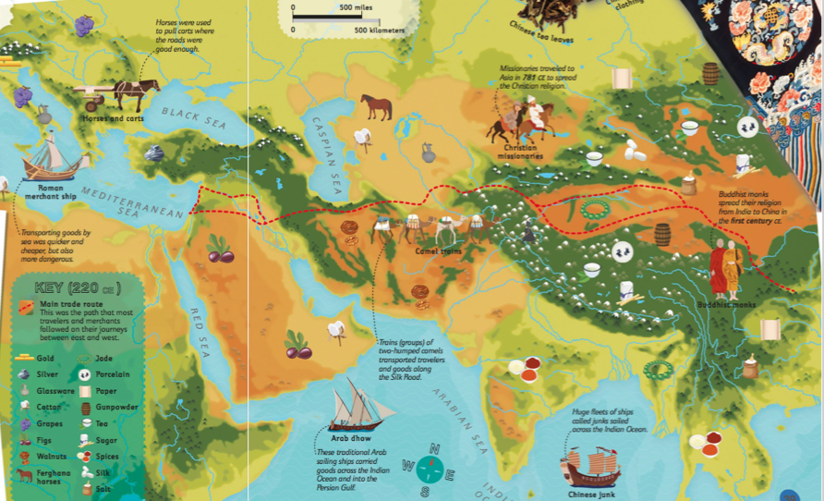
A more visual guide!

Slide 15
The Silks Roads: A Map
Mediterranean Sea
Tasks – Use the map, answer the questions in the chat.
What does this map tell us about the size of the Silk Roads?
Do you recognise any of these areas now?

Slide 16

The Silk Roads
The Silk Roads do not have a start or an end point, because they are not actually real roads at all. They are web of trade networks that flow east to west and west to east – from the pacific coasts of China and Russia to the Atlantic coasts of Europe and Africa, and also from Scandinavia in the North to the Indian Ocean in the south. Along these routes, pilgrims and warriors, nomads and merchants have travelled, goods (e.g. silk) and produce have been bought and sold, and ideas and beliefs exchanged, adapted and refined. They have carried not only prosperity, but also death and violence, disease and disaster.
You might even think of the Silk Roads as the worlds central nervous system, linking all the organs of the body together or perhaps as veins and arteries pumping oxygen and carbon dioxide away from and towards the heart. To understand the body, you need to look under the skin, an you also need to see how the body as a whole works, rather than just looking at one party of it.
Task – Answer
the questions.
Were the Silk Roads actually roads?
What does Frankopan say crossed the Silk Roads?
Where did the Silk Roads cross?
How does Frankopan describe the Silk Road, what he mean by it?

Slide 17
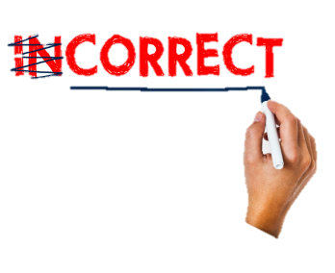
Neither Silk nor Roads
Task: What were the Silk Roads?
Using what we have done today, and the fragments, complete this following sentence to challenge the misconceptions about the Silk Roads.
Although named the Silk Roads, this is term is a misconception as...
..death and violence... | ...trade routes... | ..beliefs and ideas...
...people and culture.... | ....civilisation | ..interconnected network..
....goods... | ...East to West, and North to South....

Slide 18
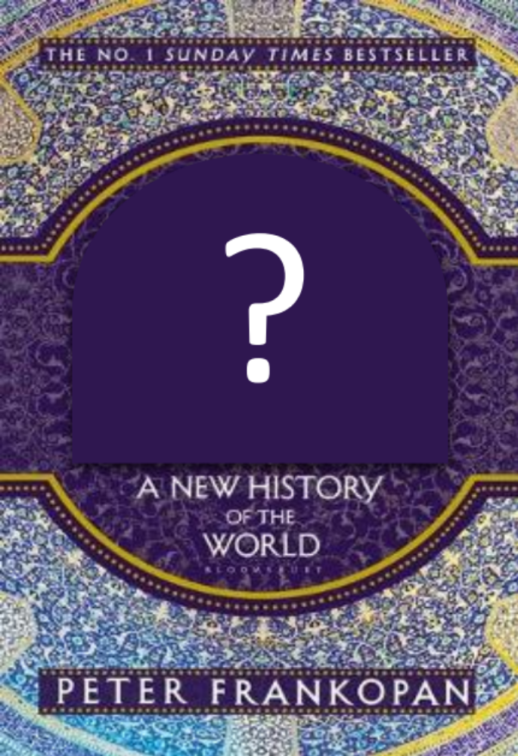
Before you leave...
If you had to give Peter Frankopan’s book a new title, what would you call it?
Write your answer on a post it note, and pin it up on the board as you pack away.

