Slide 1
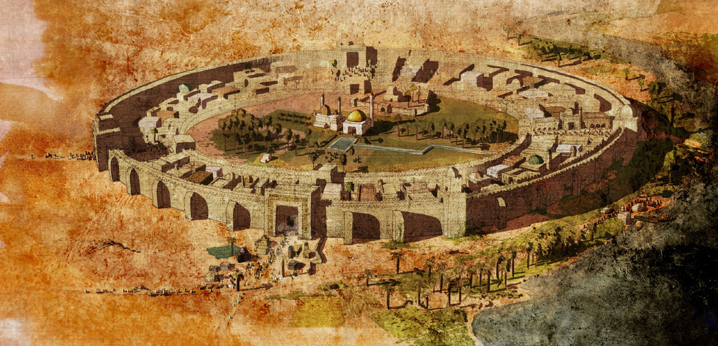
What can Baghdad tells about the spread of wisdom on the Silk Roads?
Enquiry Question: What travelled on the Silk Roads?

Slide 2
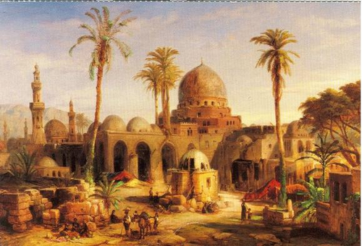
The Silk Road was a network of trade routes which connected the East and West (which allowed economic, cultural, political, and religious interactions between these regions, nations and empires.)
Introduction
As we’ve learnt, the Silk Roads connected empires, cultures and peoples across the Western and Eastern worlds, with trade, religion and also wisdom flowing between.
Today we are going to focus on Baghdad, the capital of the Islamic Empire, for our study on wisdom.
Baghdad, on the Silk Road, echoed a highpoint in Islamic civilisation, with a 2004 Guardian article stating...
Scholars accumulated the greatest collection of knowledge in the world, and built on it through their own discoveries.
What ‘wisdom’ do you think flowed across the Silk Roads?
So, how was Baghdad a hub of Wisdom on the Silk Road?

Slide 3

Key Word: Wisdom
Definition
Characteristics
The accumulation and gathering of scientific or philosophical learning.
Science, Philosophy, Language
Academic learning
Encouragement of reading
and writing
The sharing of knowledge
Wisdom
Examples
Sentence
Medicine
Science
Philosophy
Litarature
The Silk Roads helped the spread of wisdom between East and West, particularly in cities like Bagdad

Slide 4
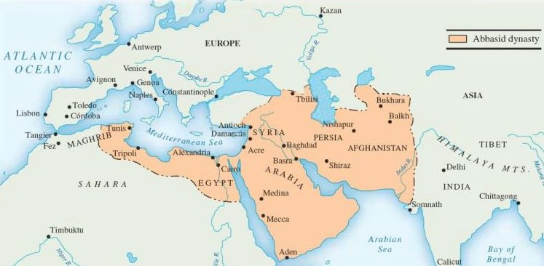
Baghdad, the centre of an empire
During the 1st century after the birth of Islam, Muslim armies defeated the Persians, expanding the Abbasid Caliphate (Islamic state/empire) to the East.
Around 762, the Abbasid Caliph (Rulers) established a capital in the newly founded city of Baghdad, where they ruled a vast empire for five centuries.
Task: Briefly summarise what this information on Baghdad

Slide 5
How can we uncover what Baghdad was like?
Lets go on a journey through Baghdad during the Caliphate to look at what can sources tell us about wisdom

Slide 6
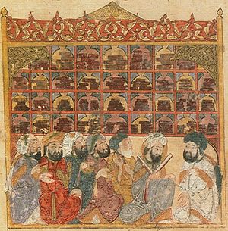
A: Scholars in a library in 13th century Baghdad

Slide 7
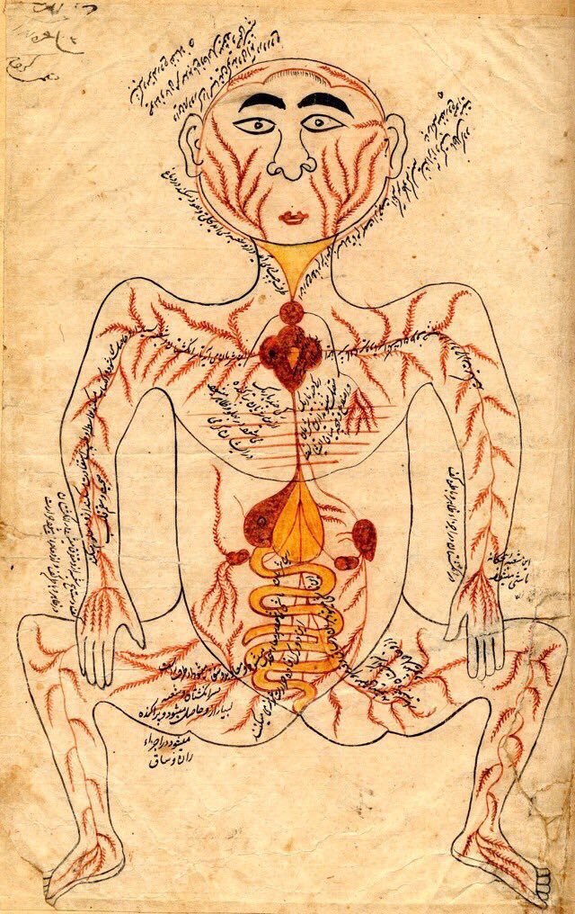
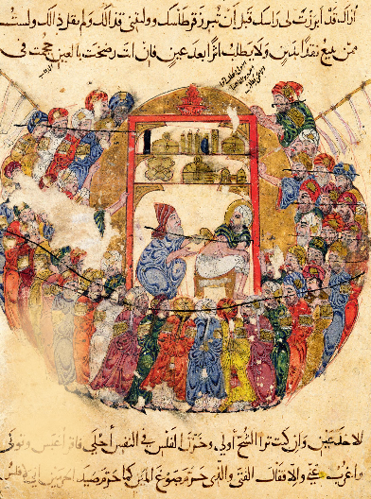
B: Diagram from a book by Ibn Al-Nafis,
C: A doctor treats wounds

Slide 8
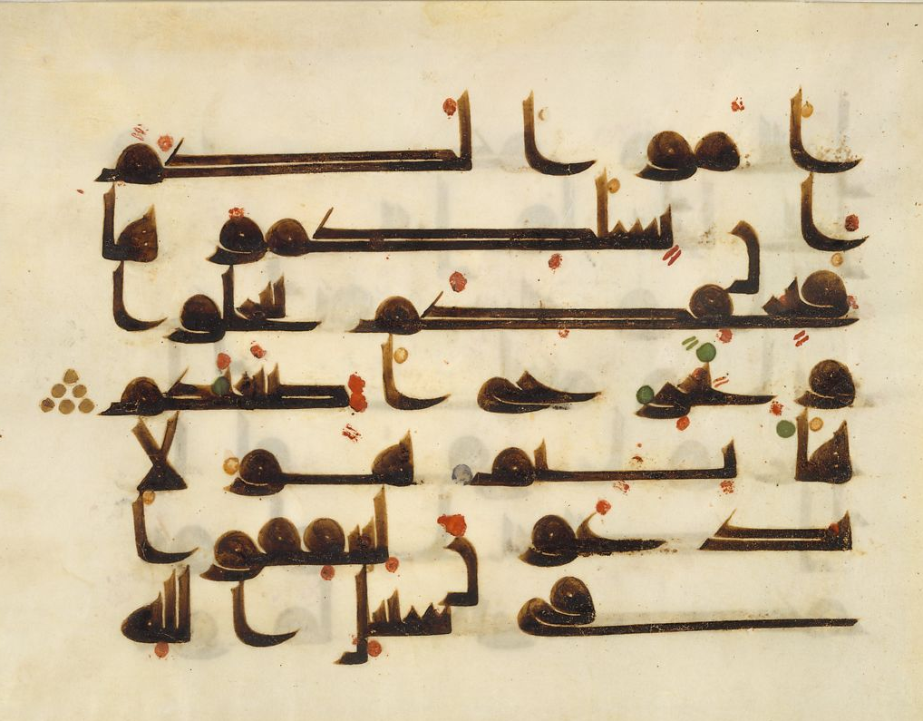
E: Folio (An individual page from a Quran Manuscript.

Slide 9
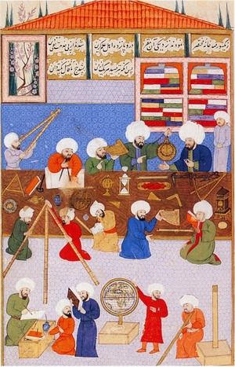
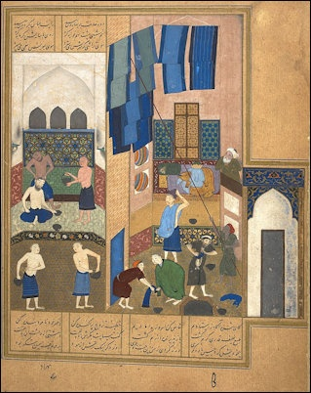
D: work in an observatory
E: A bathhouse

Slide 10
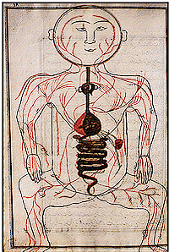
A: Scholars in a library in 13th century Baghdad
B: diagram from a book by Ibn Al-Nafis,
C: a doctor treats wounds
E: Folio (An individual page from a Quran Manuscript.
D: work in an observatory
E: A bathhouse
Task: Study these sources together
What do they tell us about wisdom in Baghdad?

Slide 11
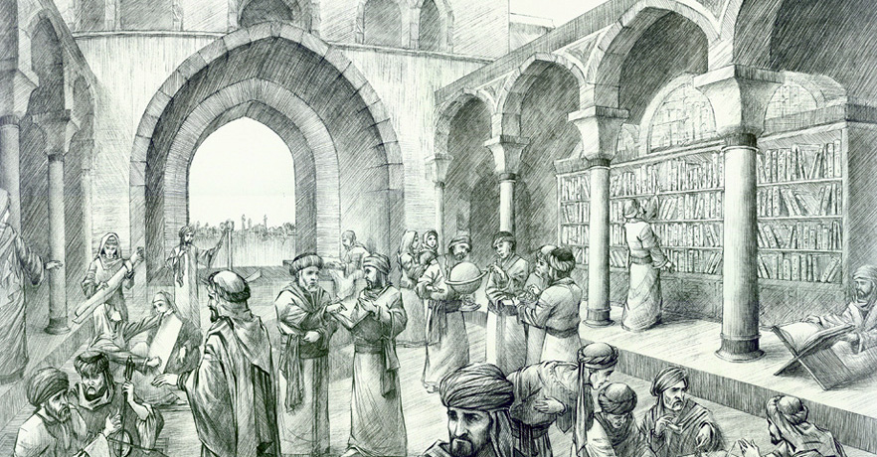
The House of Wisdom
The House of Wisdom in Baghdad, was once at the centre of learning in the Islamic Caliphate until it was lost in the 1200s

Slide 12
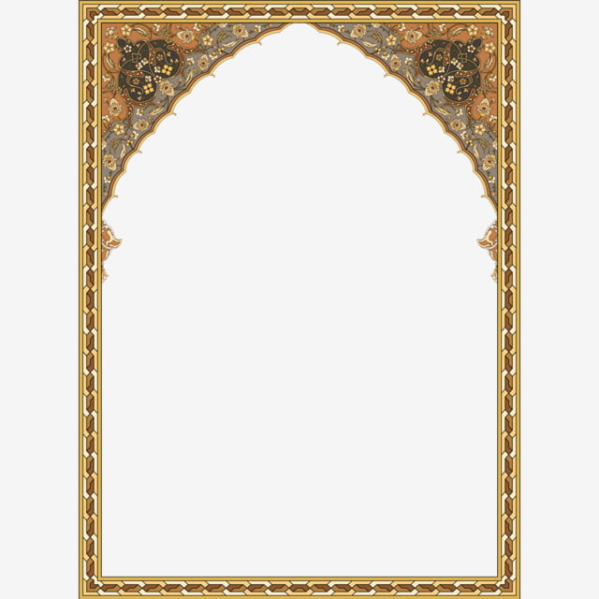
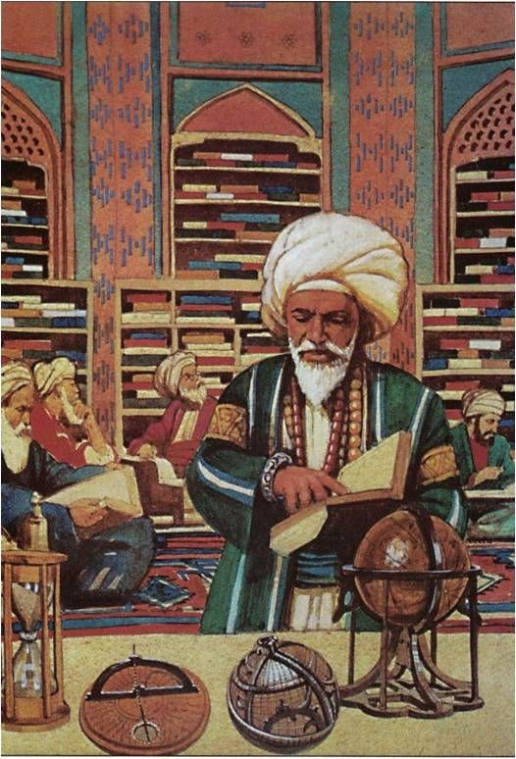

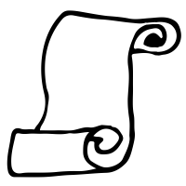
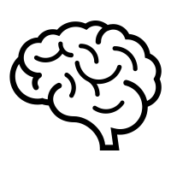
The House of Wisdom
Built primarily as a library, the House became the home of ancient wisdom containing important works of scholarship from the Eastern and Western worlds
Knowledge from East and West
(Greece, Europe and India) was taught and shared within the house.
Technological developments such as the production of paper came from China, which allowed more books to be made.
As great minds flocked the House, Architecture, literature, art and translations blossomed within the library.

Slide 13
Task: The House of Wisdom
The House of Wisdom in Baghdad, was once a center of learning in the Islamic Caliphate, it was lost in 13th century. Built primarily as a library, the House became the home of ancient wisdom containing important works of scholarship from the Eastern and Western worlds. Knowledge from East and West (Greece, Europe and India) was taught and shared within the house, whilst technological developments such as the production of paper came from China, which allowed more books to be made. As great minds flocked the House, Architecture, literature, art and translations blossomed within the library.
Use the information to complete the below question words and use the notes to explain what the important of the House of Wisdom
______________________________________________________________________________________________
______________________________________________________________________________________________
______________________________________________________________________________________________
_______________________________________________
Who
What
When
Where
Why

Slide 14
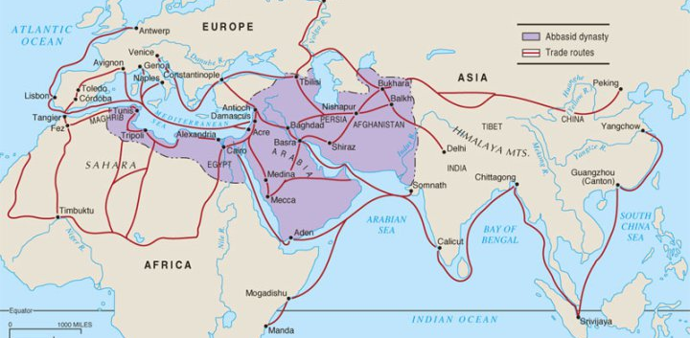
Why did Baghdad become
so full of ‘wisdom’?
Look at this map of the Silk Roads and the Muslim Caliphate
Why might this explain why Baghdad become so full of ‘wisdom’?

Slide 15

Frankopan on Baghdad
Baghdad became the beating heart of the Islam empire. It was the richest and most populous city on earth, and remained so for centuries. Trades from far and wide as traders flocked to markets awash with buyer, bringing wisdom!
Great support was given to scholars and their research. Race, religion and even gender were not barriers for those who were clever, with scholars gathering materials from all corners of the world. Great attention was paid to learning about Asian culture, and how its people lived and behaved.
This was a time that saw major breakthroughs in science, mathematics, medicine and astronomy, literature and philosophy. Texts were written how to understand Greek Philosopher Aristotle or Homer. This was a time when even the most powerful leaders in Europe could not read.
Delight was taken in mathematical concepts, from the significance of zero to algebra and algorithms. Some did experiments on medicines whilst other scientists worked on problems like the relationship between the vision and brain.
Task : Discuss
then answer these questions.
How did Baghdad encourage wisdom to develop and spread?
What examples can we see of the Silk Road helping wisdom spread?
In what areas did Wisdom grow in Baghdad?

Slide 16

Which one best represents the wisdom of Baghdad was like?
Which of source best represents the wisdom of Baghdad?
Choose one
Explain your decision using the sentence starter and key words
Sentence Starter
Source....., which is a...........best represents how the wisdom of Baghdads as......
A: Scholars in a library in 13th century Baghdad
B: diagram from a book by Ibn Al-Nafis,
D: work in an observatory
Medicine | Silk Roads | Learning
Wisdom | Caliphate | House of Wisdom
Science | Scholars | Islam
E: Folio from a Quran Manuscript.
C: a doctor treats wounds
E: A bathhouse

Slide 17

Final Tasks
Complete the Forms Quiz based on todays lesson, its in assignments
Submit a photo of your work using ‘hand in’ on Assignments
Notes:
https://forms.office.com/Pages/ShareFormPage.aspx?id=UnUXwBfB0EegT_XH7JOp2dzn0ewHnJhIp9fx7IuFvEpURDZSUlU1UFNZNTRNTEVIOUlXQzE3Vkw0RS4u&sharetoken=afYWrJnsAU1n2ZpPaS1S

