Slide 1
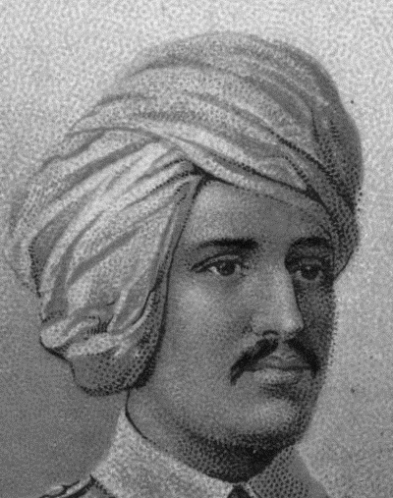
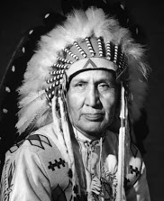
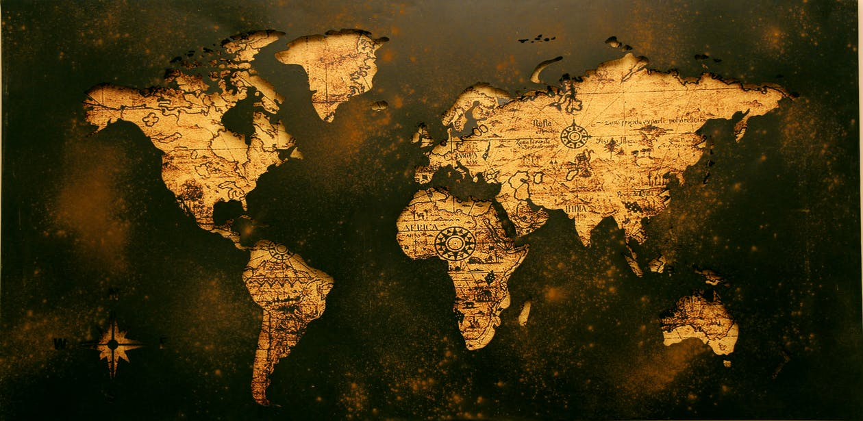
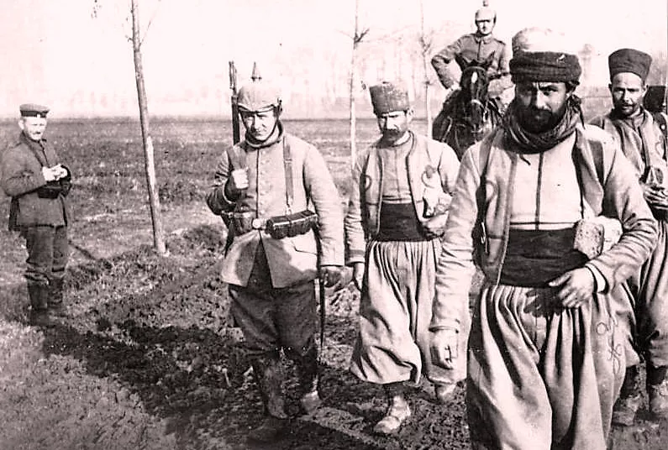
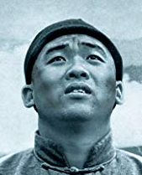
What links these men together?

Slide 2
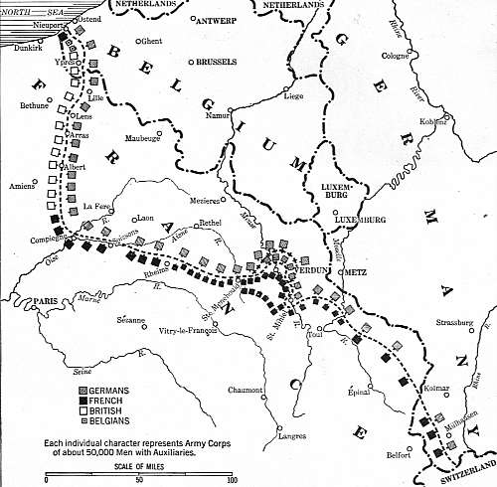
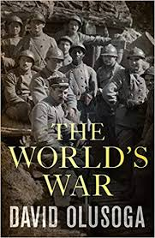
They all served on the Western Front, for the British Army!

Slide 3
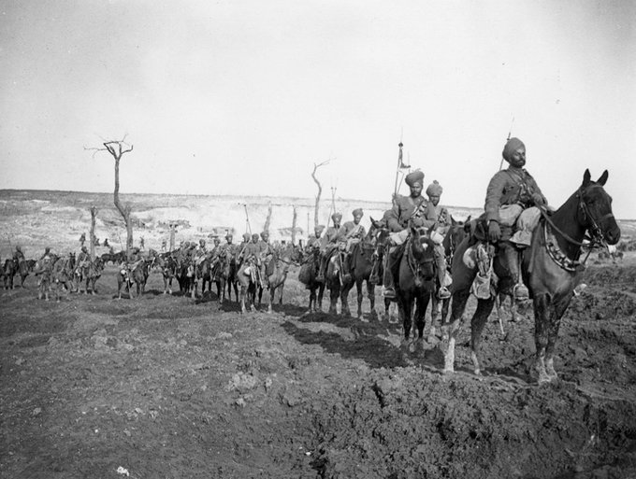
What do the stories of the ‘often forgotten armies’ reveal about the Western Front?
Enquiry Question: Experiences in the First World War

Slide 4
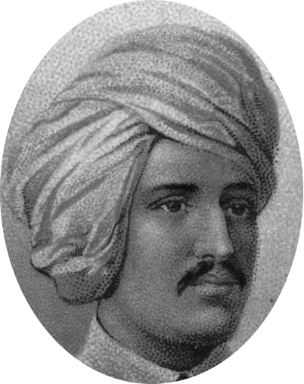
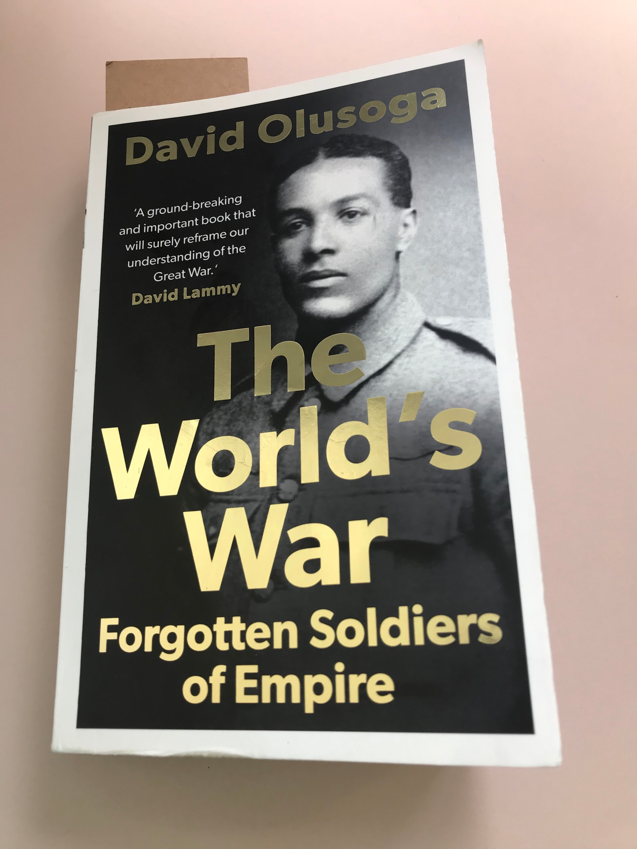

The Silk Road was a network of trade routes which connected the East and West (which allowed economic, cultural, political, and religious interactions between these regions, nations and empires.)
Introduction
This topic so far we have focussed on the British fighting on the Western Front, but who actually fought for Britain?
Historian David Olusaga, author of The Worlds War, has this to say.
Our focus today looks
at the experiences of
Ganga Singh, a soldier
of the British Empire
Ganga fought as part of the Indian Corps near Ypres between 1914-15 and his experiences provide a new perspective into life on the Western Front for soldiers.
‘Seventy million men were mobilised during the First World War… 4 million non-white, non-European soldiers… fought for Britain, France and their allies. The trenches were a Babylon of races”
Can you think of any countries who fought for us? Think of our empire
So, what can the stories of ‘often forgotten armies’ reveal about the Western Front?

Slide 5

Recap: Empire
Today we are looking at the troops who fought for the British Empire. We covered empire in Year 7, but can you remember what it means?
Write a definition out and we will compare to our Frayer definition
Definition
Characteristics
The ruling country has a strong government and army
Covers a large geographical area, encompassing many different ethnicities are ruled
When a group of countries (colonies), is ruled over by a single country.
Empire
Examples
Non Examples
The British Empire
The Roman Empire
The Ottoman Empire
England
The United Nations
The EU

Slide 6

Who were the Empire soldiers?
Watch this video & complete
Where soldiers come from to serve in WW1?
What roles did they have in the British army?

Slide 7
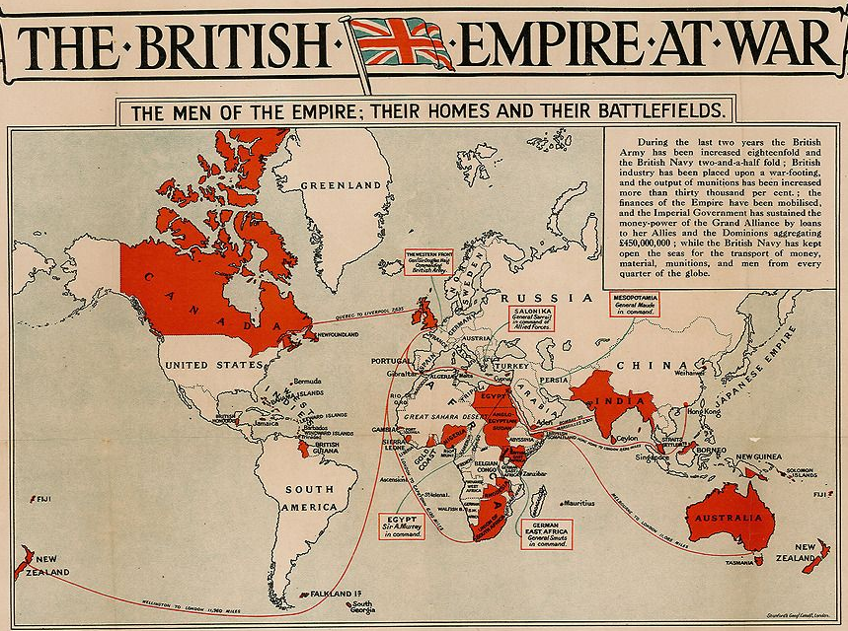
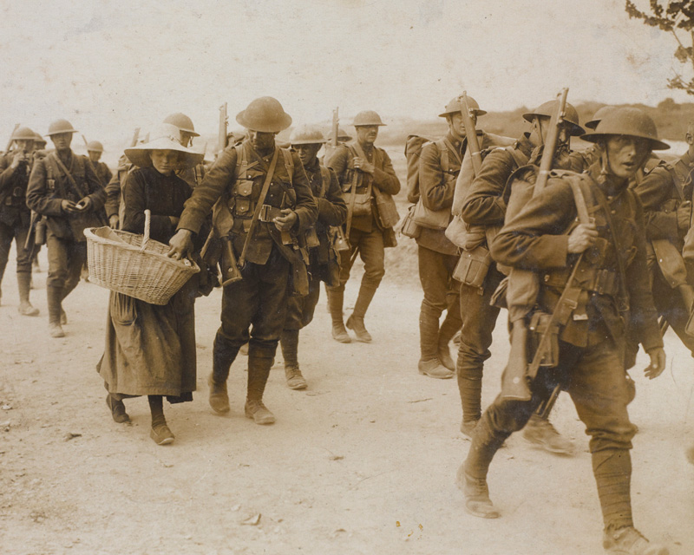
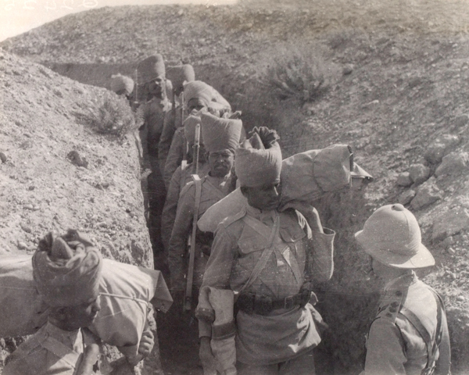
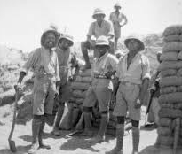
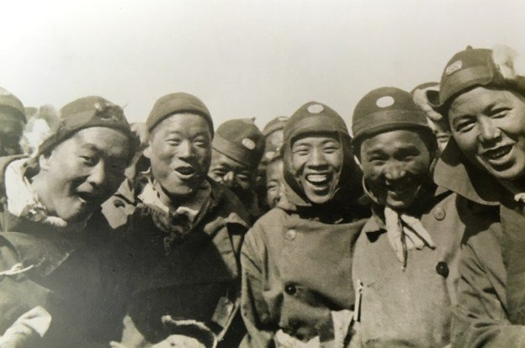
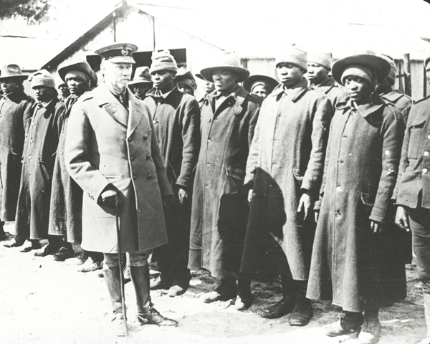
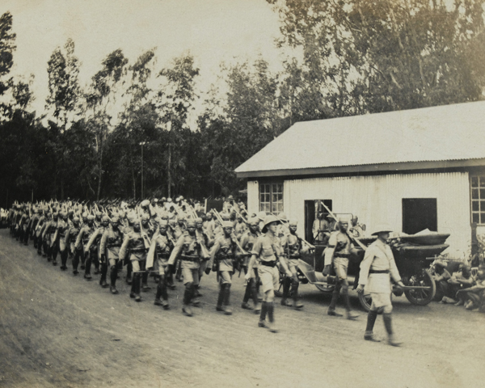
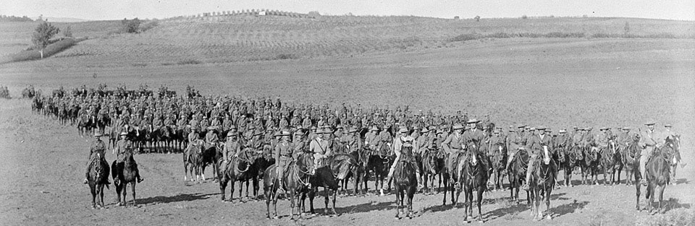
Who are the forgotten of the British Army?
Britons did not die alone in the First World War; they fell alongside men from our vast empire. Many of these have been forgotten in history
620,000
Canadians
74,000 Indians
(India/Pakistan)
10,000 Jamaicans
10,000 Chinese
’Volunteers”, who were not from the empire
105,000 South Africans
180,000 Africans
(Nigeria, Ghana, Kenya, Uganda)
510,000 Australians and New Zealanders
180,000

Slide 8
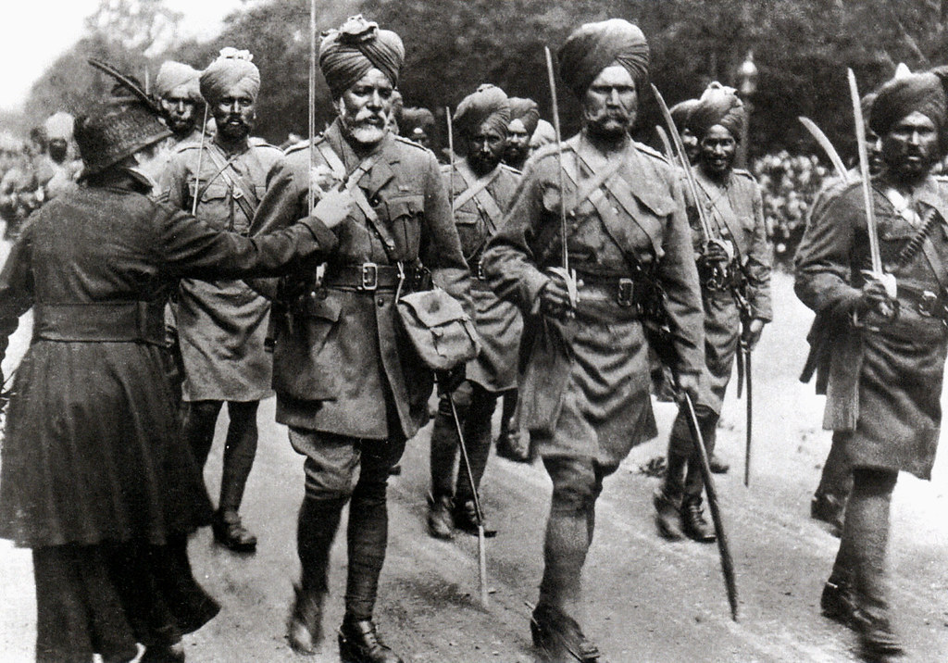
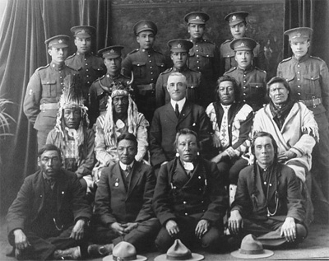
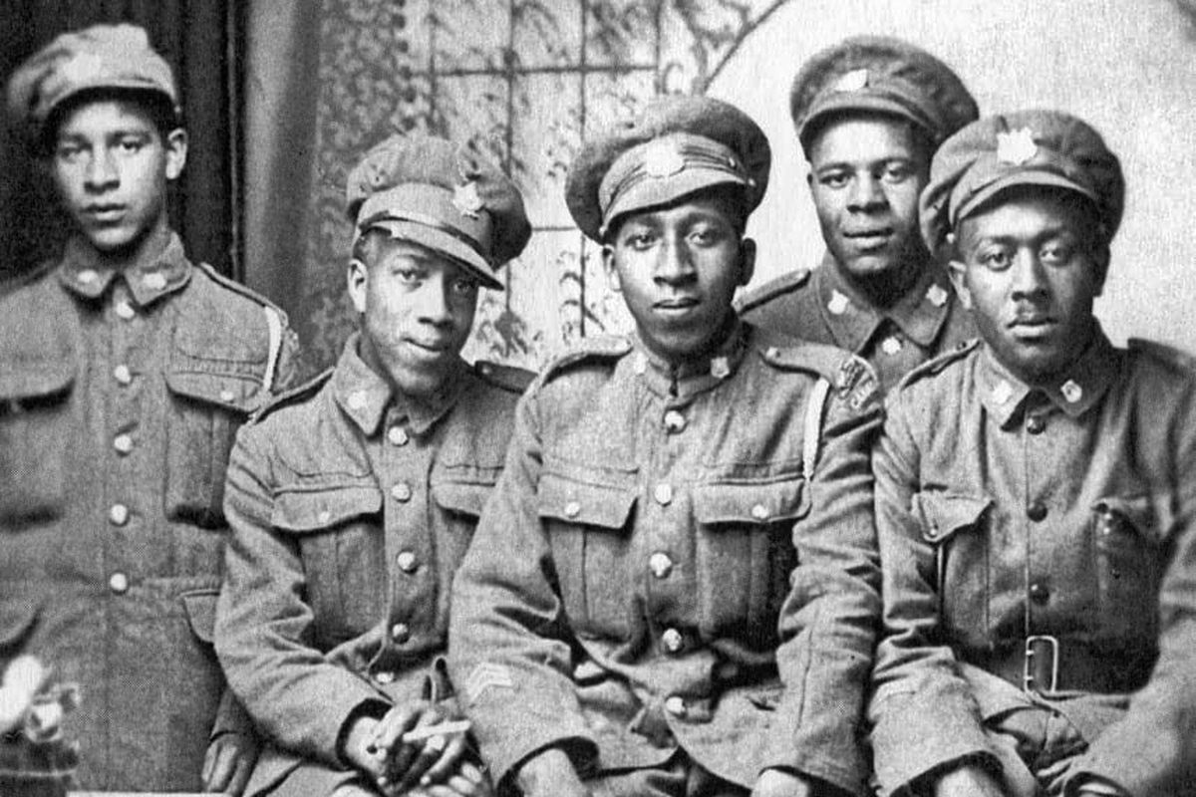
Sikh Troops
Canadian Natives
Chinese Labour Corps
Jamaican Troops

Slide 9
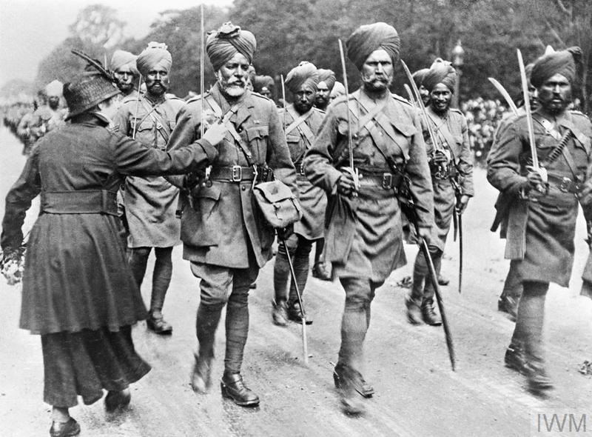
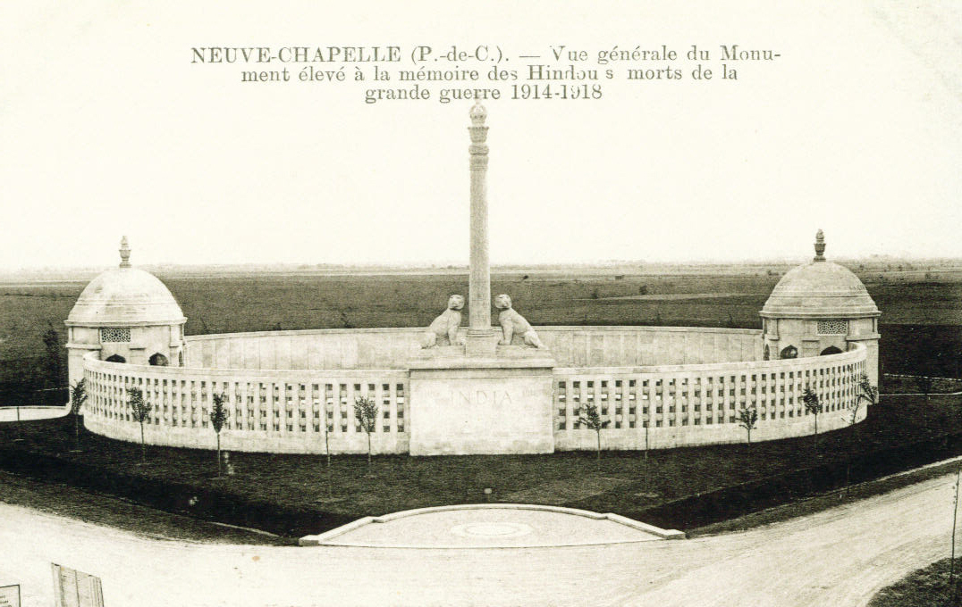
India in the First World War
Approximately 1.3 million Indian soldiers served in World War One - and more than 74,000 of them lost their lives.
Roughly 130,000 served on the Western Front at:
The Somme
Ypres
Cambrai
They have their own memorial at Neuve Chappele

Slide 10

Case Study: Ganga Singh
Today we will focus on Ganga Singh, who fought as part of the Indain 57th Wildes Rifles on the Western Front.
He was ’on the line’ over the winter of 1914-15, surviving the First Battle of Ypres and the war.
What can his experiences reveal about life on the Western Front for our empire solders?
We are going to read the story of Singh and look at 4 areas.
Copy out this table onto paper. Give 6 lines for each box.
Weapons and new technology | Military Strategy
Treatment of troops and life on the front line | The psychological effects of war

Slide 11
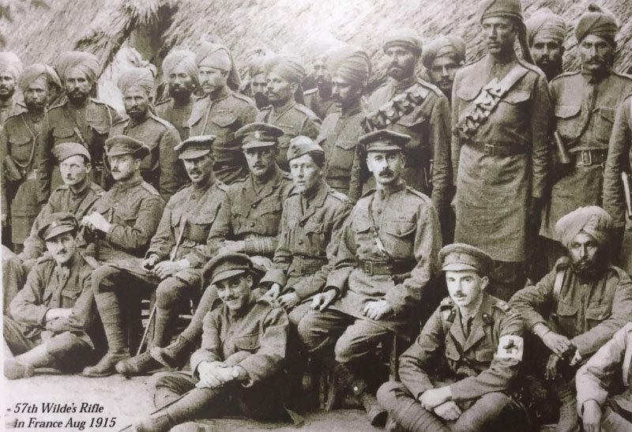
Notes:
This is his regiment

Slide 12
Sikh Cavalry at the Somme, on the Western Front, 1915

Slide 13
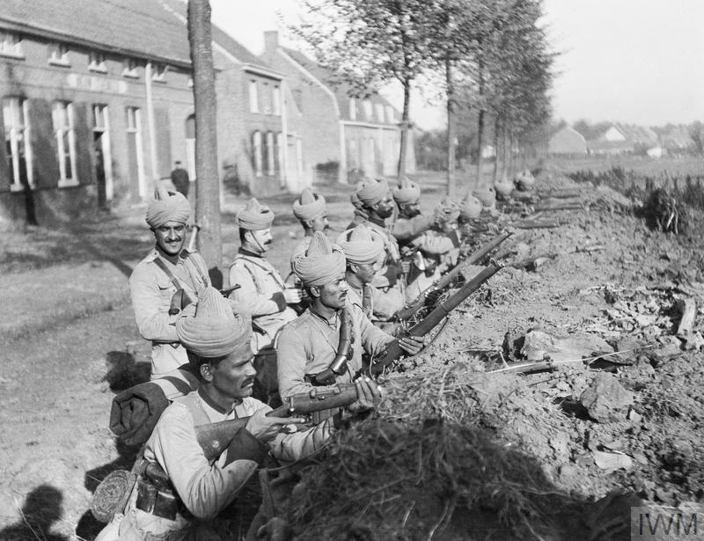

Slide 14

The Story of Ganga Singh
It is October 1914. Ganga Singh, of the 57th Rifles, crouches in a muddy ditch. Despite his awkward position, he feels comfortable in his thin tropical uniform. Looking up, he can see blue skies and green leaves.
Singh is quiet and watchful. His makeshift trench is within the range of German guns. There is no barbed wire to stop attackers. The Germans facing Singh have both artillery (cannon) support and hand grenades. Singh’s regiment, meanwhile, has just two machine guns, and no grenades. Instead, Singh holds a jam jar filled with dynamite.
Singh looks around at the other men. The Indian army has been thrown hurriedly into battle to patch holes in British lines. Where are his friends? Who is the man at the other end of the ditch, shouting orders in an unintelligible language? Singh feels a sense of dislocation, of isolation, of loss.
Singh shoulders his new Mark III rifle which feels heavy in his arms. The new sighting system will take time to master. Singh’s regiment is desperately outnumbered. If the Germans capture the ridge he is holding, they will probably also capture the Channel ports: an unthinkable disaster.
Task
Fill your table as you read Ganga’s narrative from the start of the war in 1914
What can you see about weapons/technology
What can you see about military strategy?
What can you see about treatment of troops?
What can you see about the phycological affects of war?

Slide 15
The Story of Ganga Singh
Singh tries to remain calm. How had he got here?
He remembers the ship that set him down just a few weeks ago. He remembers a long journey across the black waters of the deep oceans. He remembers cigarettes placed in his hands as he arrived. He remembers flowers pinned to his tunic. He remembers sitting cross-legged on the grass with the rest of his regiment. He thinks he is somewhere near Paris, or did the officer say Persia?
Singh is a veteran. He has experience. He is part of the largest volunteer army in the world. The Battle of Mons had showed the British how strong the German force was. The British now need the Indian Army to plug gaps in the front lines.
The shelling is continuous. Hour by hour, the ancient town of Ypres is being pounded into rubble. Singh carefully puts down his jar. He has heard the sound of enemy approach. He picks up the bayonet. He shoots. One, two, three, four, five. Five German soldiers are killed. The bayonet breaks in two. Ignoring the jar, he picks up a sword. He fights on until he collapses, wounded.
He is later found alive when the Germans are gone. The trenches he had so ferociously defended are successfully re-taken by the 5th Dragoon Guards.
Task
Fill your table as you read Ganga’s narrative from the start of the war in 1914
What can you see about weapons/technology
What can you see about military strategy?
What can you see about treatment of troops?
What can you see about the phycological affects of war?

Slide 16
Let’s share what we found
Weapons and new technology | Military Strategy
Treatment of troops and life on the front line | The psychological effects of war
How does this support/contradict what we already know?
Notes:
Weapons and new technology
Given new and unknown weapons (e.g. rifle) and not trained to use them; dynamite in a jam jar:
problems with equipment
Military Strategy
Indian troops being used to plug gaps in British lines
Treatment of troops and life on the front line
Expected to fend for himself; not issued a uniform that’s fit for purpose; almost seen as expendable?
The psychological effects of war
Feeling of alienation, lack of safety – he can’t understand his officers!
Disorientation: Paris or Persia?!

Slide 17




What does Singh reveal
about the Western Front?
The below are 3 things we learnt from Singh, but what does that tell us about the Western Front? What claims we we reasonably make?
Point: Indian soldiers were used to plug gaps in British lines
1. The British were in trouble in 1914
3. Indian soldiers were better than British
2. Indian soldiers were an important part of the British army
4. Indian soldiers weren’t very good fighters
Point: Singh couldn’t find or understand officers.
1. British officers were stupid
3. Indian soldiers didn’t bother learning English
2. There were soldiers from different countries on the Western Front
4. The Western Front was a chaotic place
Fact: Singh killed 5 Germans during the Battle of Ypres
1. The war was traumatic for soldiers
3. The British won the Battle of Ypres
2. The Germans were poor soldiers
4. The war led to huge casualties
Notes:
Weapons and new technology
Given new and unknown weapons (e.g. rifle) and not trained to use them; dynamite in a jam jar:
problems with equipment
Military Strategy
Indian troops being used to plug gaps in British lines
Treatment of troops and life on the front line
Expected to fend for himself; not issued a uniform that’s fit for purpose; almost seen as expendable?
The psychological effects of war
Feeling of alienation, lack of safety – he can’t understand his officers!
Disorientation: Paris or Persia?!

Slide 18
What does the experience of Ganga Singh reveal about the Western Front?
Complete the sentence to answer the question
Use an appositive about Ganga Singh
Provide 2 things we learnt about the experience of Empire troops from Singh.
The story of Ganga Singh, a.................., reveals the experiences of British empire troops on Western Front as it tells us………………Singh also reveals that…..
Core Vocabulary
We |  | Western Front | Trench | Psychological | Conditions

Slide 19
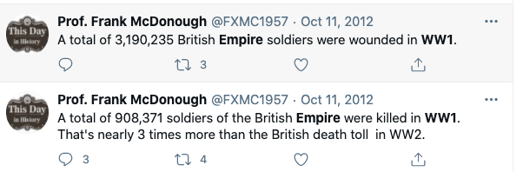

Discussion
These facts were tweeted by historian Professor Frank McDonough, they are incredible statistics.
Should we do more to share the experience and contribution of Britain's empire troops?

Slide 20

Final Tasks
Complete the Forms Quiz based on todays lesson, its in assignments
Submit a photo of your work using ‘hand in’ on Assignments
Notes:
https://forms.office.com/Pages/ShareFormPage.aspx?id=UnUXwBfB0EegT_XH7JOp2dzn0ewHnJhIp9fx7IuFvEpUMVVZN0JNUDVDUlhTOFIxRkhNWEpQVFQzQS4u&sharetoken=pMVWLXTm3rZ5d40qAf5V

Slide 21
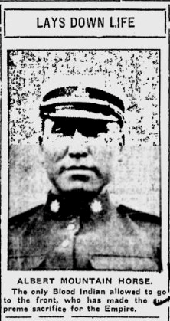

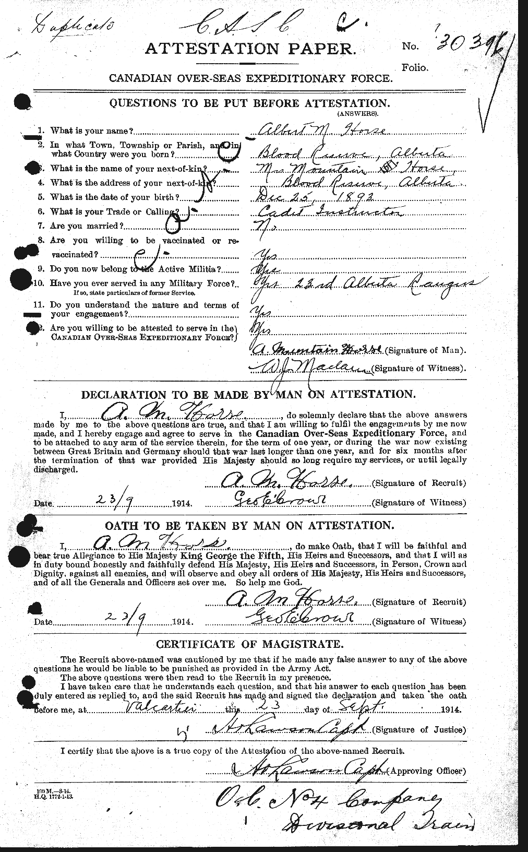
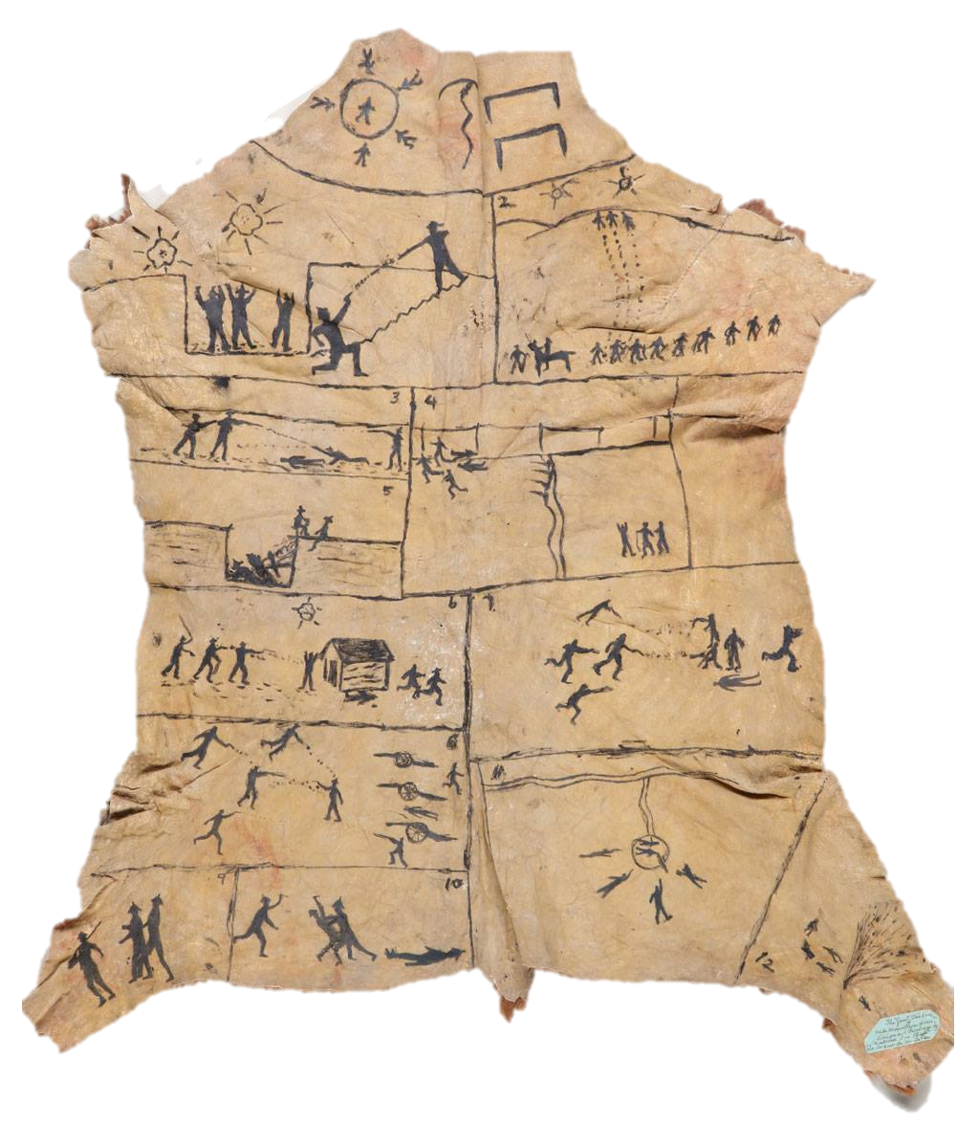
Extra: Mike Mountain Horse
Are you interested in finding out more? Research Mike Mountain Horse, the Native Canadian who fought at the Battle of Cambrai

